Slide 1
ASC - USA WEST
“Feeble forces that unite become strong.
A single strand may be easily broken,
but a three-ply cord is hard to break."
- Don Bosco

Slide 2
Texas Centers
Austin – Cristo Rey Church
15 members
4 aspirants
Laredo - Mary Help of Christians School
5 members
6 aspirants
San Antonio – St. John Bosco School
18 members
2 aspirants

Slide 3
Northern California Centers
Sts. Peter and Paul
18 members
3 aspirants
Salesian High Richmond
8 members
Coming Soon:
St. Francis High School
Corpus Christi Church
Notes:
Corpus Christi – Fr. Jesse has 30 people interested in becoming cooperators. He and Sr. Mary Link have not begun a program yet, but he also went to the Form the Formator workshop so they

Slide 4
Southern California Centers
St. Mary’s Church
6 members
St. Bridget’s Chinese Catholic Church
24 members / 16 newly inducted
St, Dominc Savio Spanish Speaking
16 members / 5 new
New class forming
St. Dominic Savio English Speaking
12 members / 2 new
6 aspirants
St. Joseph Retreat Center
15 members
8 aspirants

Slide 5
APOSTOLIC WORKS
2018-2019

Slide 6
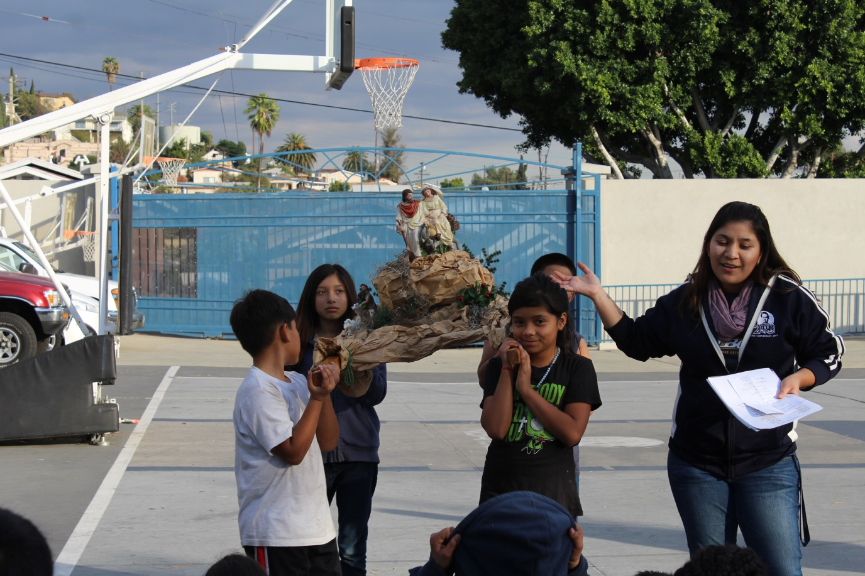
Catechesis
Sacramental Preparation, Religious Education,
RCIA, Bible Studies

Slide 7
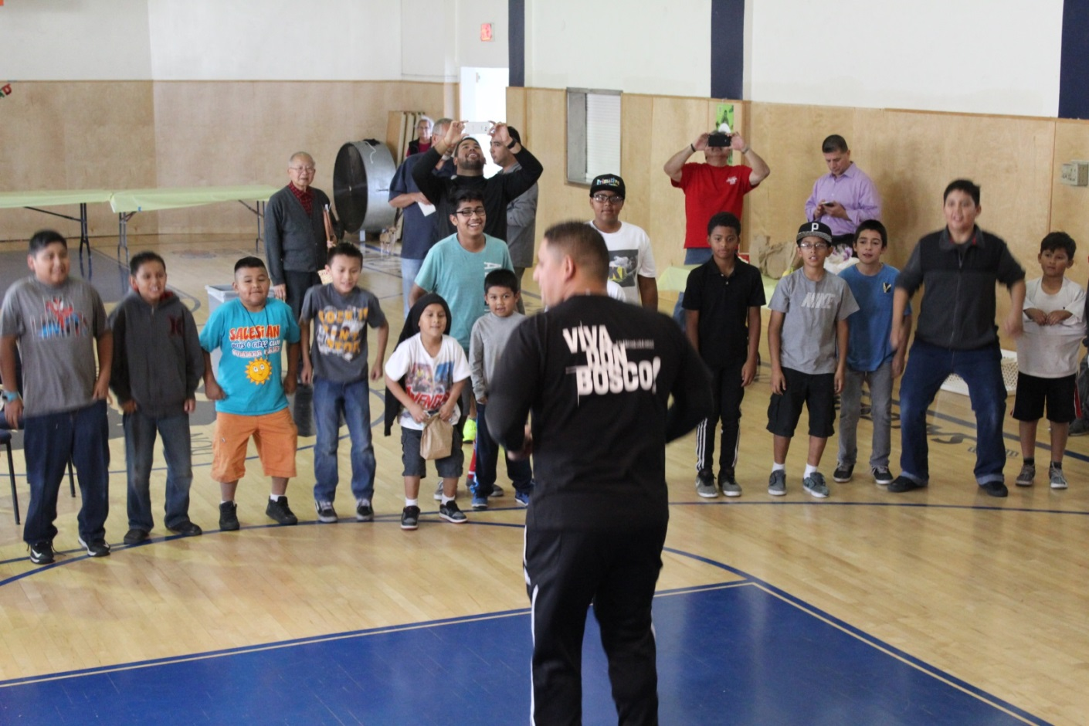
Youth Oratories
Animation, support and funding

Slide 8
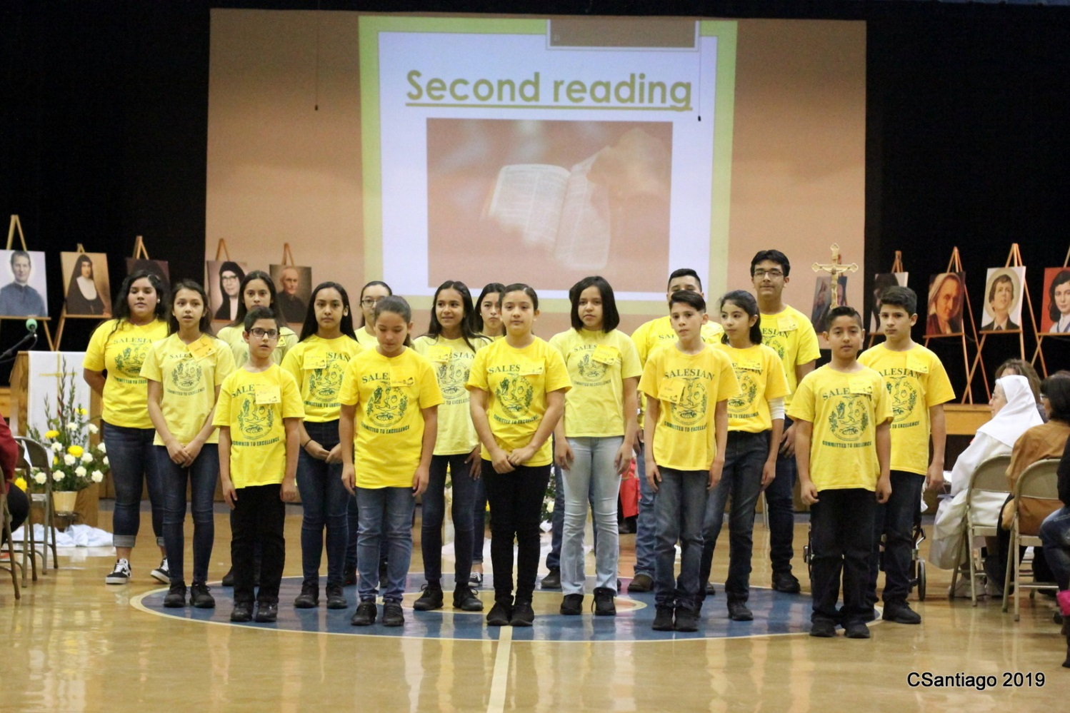
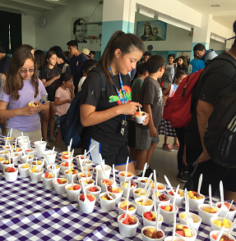
Summer Camps

Slide 9
Catholic Schools and Public Education
Notes:
Mike’s Campus Ministry Team at St. Paul’s
Elizabeth is on a School Board

Slide 10
SDB Province Youth Ministry Team

Slide 11
Refugees and Migrants
Service trips to Desayunador and the Salesian oratories in Tijuana; Christmas outreach to children in migrant camps in Watsonville, CA.

Slide 12
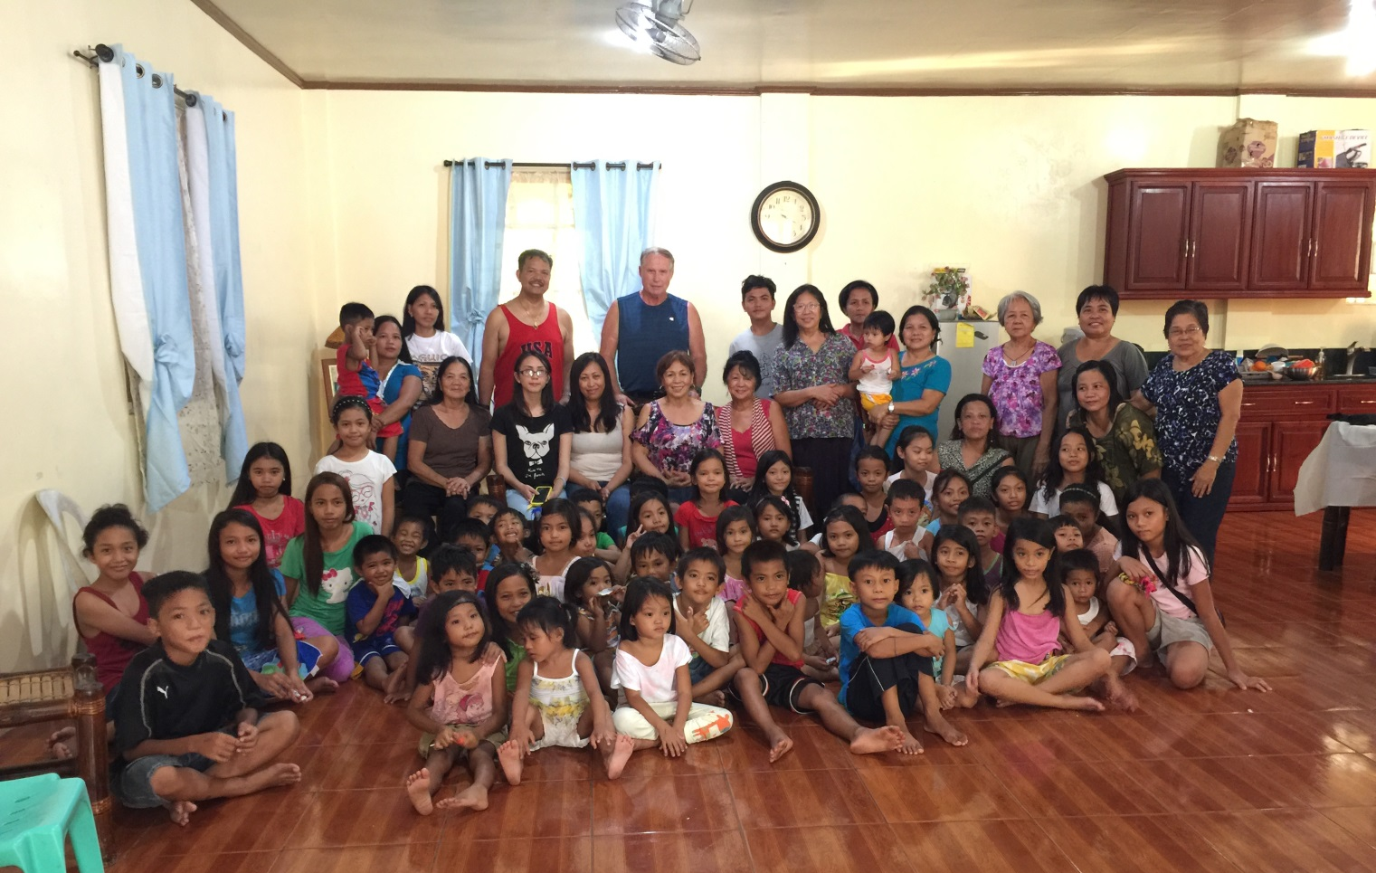
Poor and Marginalized
Homelessness, Youth in Detention, At Risk Pregnancies, Ministry with the Sick and Dying; Oratory in the Philippines
Notes:
Homelessness – St. Joe’s has retreats for homeless women and Cooperators cook for them. They also take food to the homeless every month
Julie Cordova and others go for catechesis with youth in Detention; Deacon Carlos is an aspirant who is now the Chaplain for LA Juvenile Hall
Your Ministry ☺
Cooperators visit the sick – our own, SDBs and elder care homes
Maria Noriega-Peti is trained for hosptial ministry with those who are dying and have no one to be there for them
Image is from Willy and Carmen’s outreach in the Philippines for which Carmen gave her family home for catechesis and other activities in a parish where resources are very limited.

Slide 13
PROVINCE HIGHLIGHTS
2018-2019

Slide 14
ASC World Congress 2019
To be co-responsible for our mission WITH young people
to be a “Salesian Cooperators Association that speaks up and defends the world’s boys and girls always and everywhere.” - Don Angel Fernandez Artime

Slide 15
Form the Formators Workshop
Collaborating with USA East and Canada
June 27-30, 2019
24 Participants from USA West
Development of the “Compendium to the Project of Apostolic Life”
Notes:
The Compendium was the fruit of two years of collaboration where cooperators from all provinces gathered support resources from our ASC world that deepen unerstanding of each statute in the PAL.

Slide 16
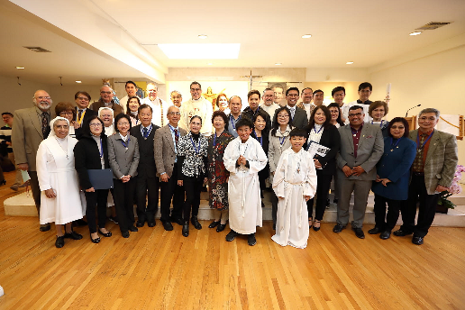
Three Cooperator Inductions
In 2019 we inducted 24 new Cooperators in our province
Notes:
St.Bridget’s and Savio 18 inductees in May 2019

Slide 17
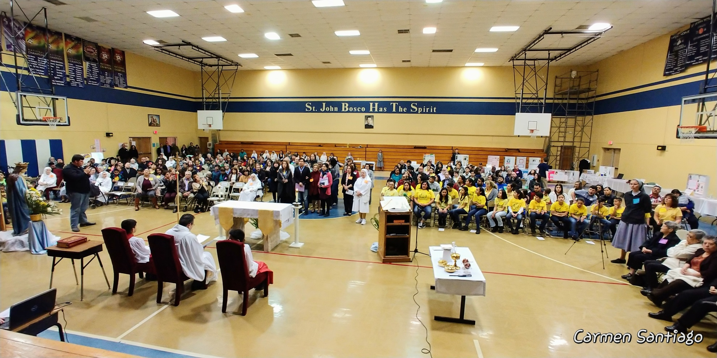
Two Salesian Family Days
Texas and Southern California

Slide 18
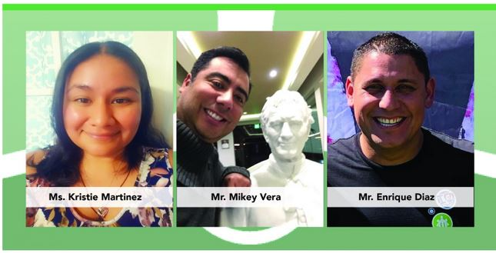
Election of New Council

Slide 19
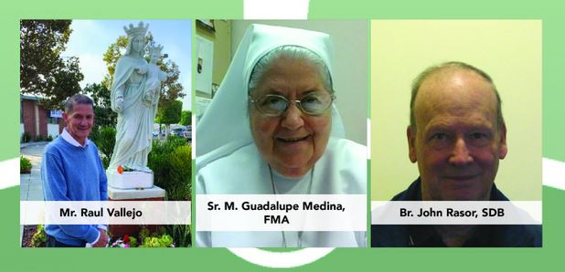
Election of New Council

Slide 20
“To be credible witnesses of our vocation…
Carrying out hope and faith-filled, life-based projects, with and for young people, as a response to the changes of the modern world.”
- Our Dream
Notes:
Dr. Ng who has given generously in his life as Local Center Coordinator and parish leader at St. Bridget’s Church, handing out baby Jesus to the children at a Christmas Oratory for the Salesian Boys and Girls Club.

