Slide 1


Association of Salesian Cooperators
St. Philip the Apostle Province (SUE)
October 2019
Inter-America Region Encounter
Puebla, Mexico

Slide 2
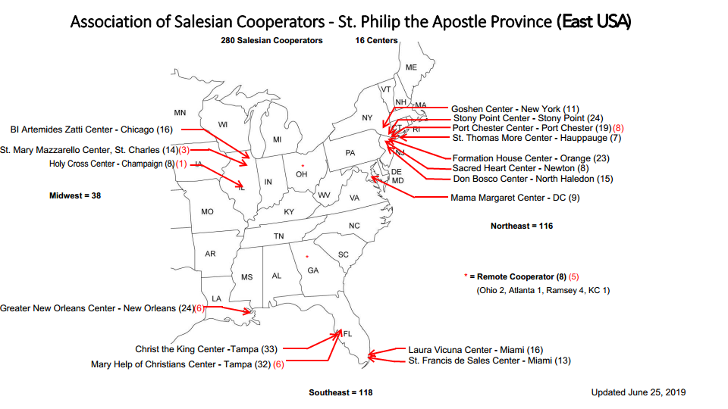
Association of Salesian Cooperators
St. Philip the Apostle Province (SUE)
Association of Salesian Cooperators
St. Philip the Apostle Province (SUE)
June 2019
August 2017

Slide 3
FORMATION
29 new cooperators since August 2018 (about 10% growth)
Most Centers have 2+ aspirants in staggered formation
youtube video segments for continuing formation
Association of Salesian Cooperators
St. Philip the Apostle Province (SUE)
June 2019

Slide 4
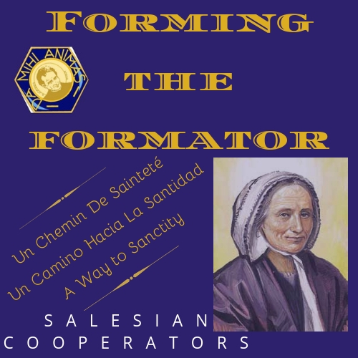
Forming the Formator
June 28-30, 2019, Stony Point, NY

Slide 5


Slide 6
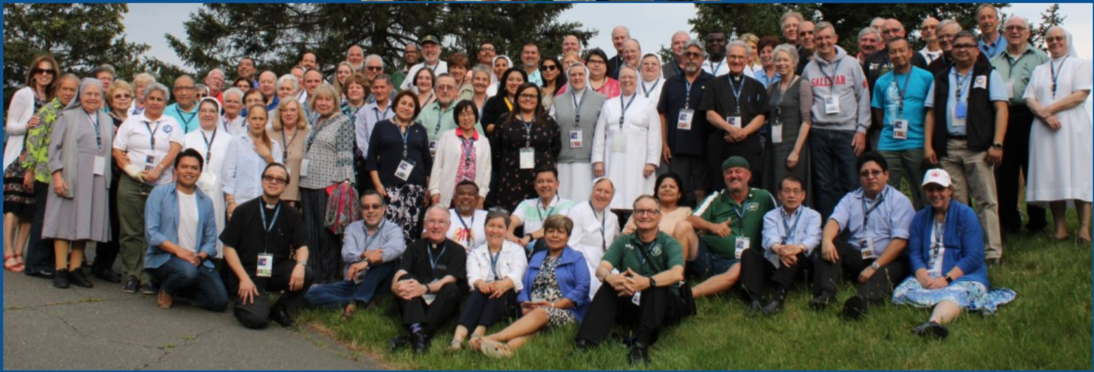
Forming the Formator
June 28-30, 2019, Stony Point, NY
Association of Salesian Cooperators
St. Philip the Apostle Province (SUE)
June 2019

Slide 7
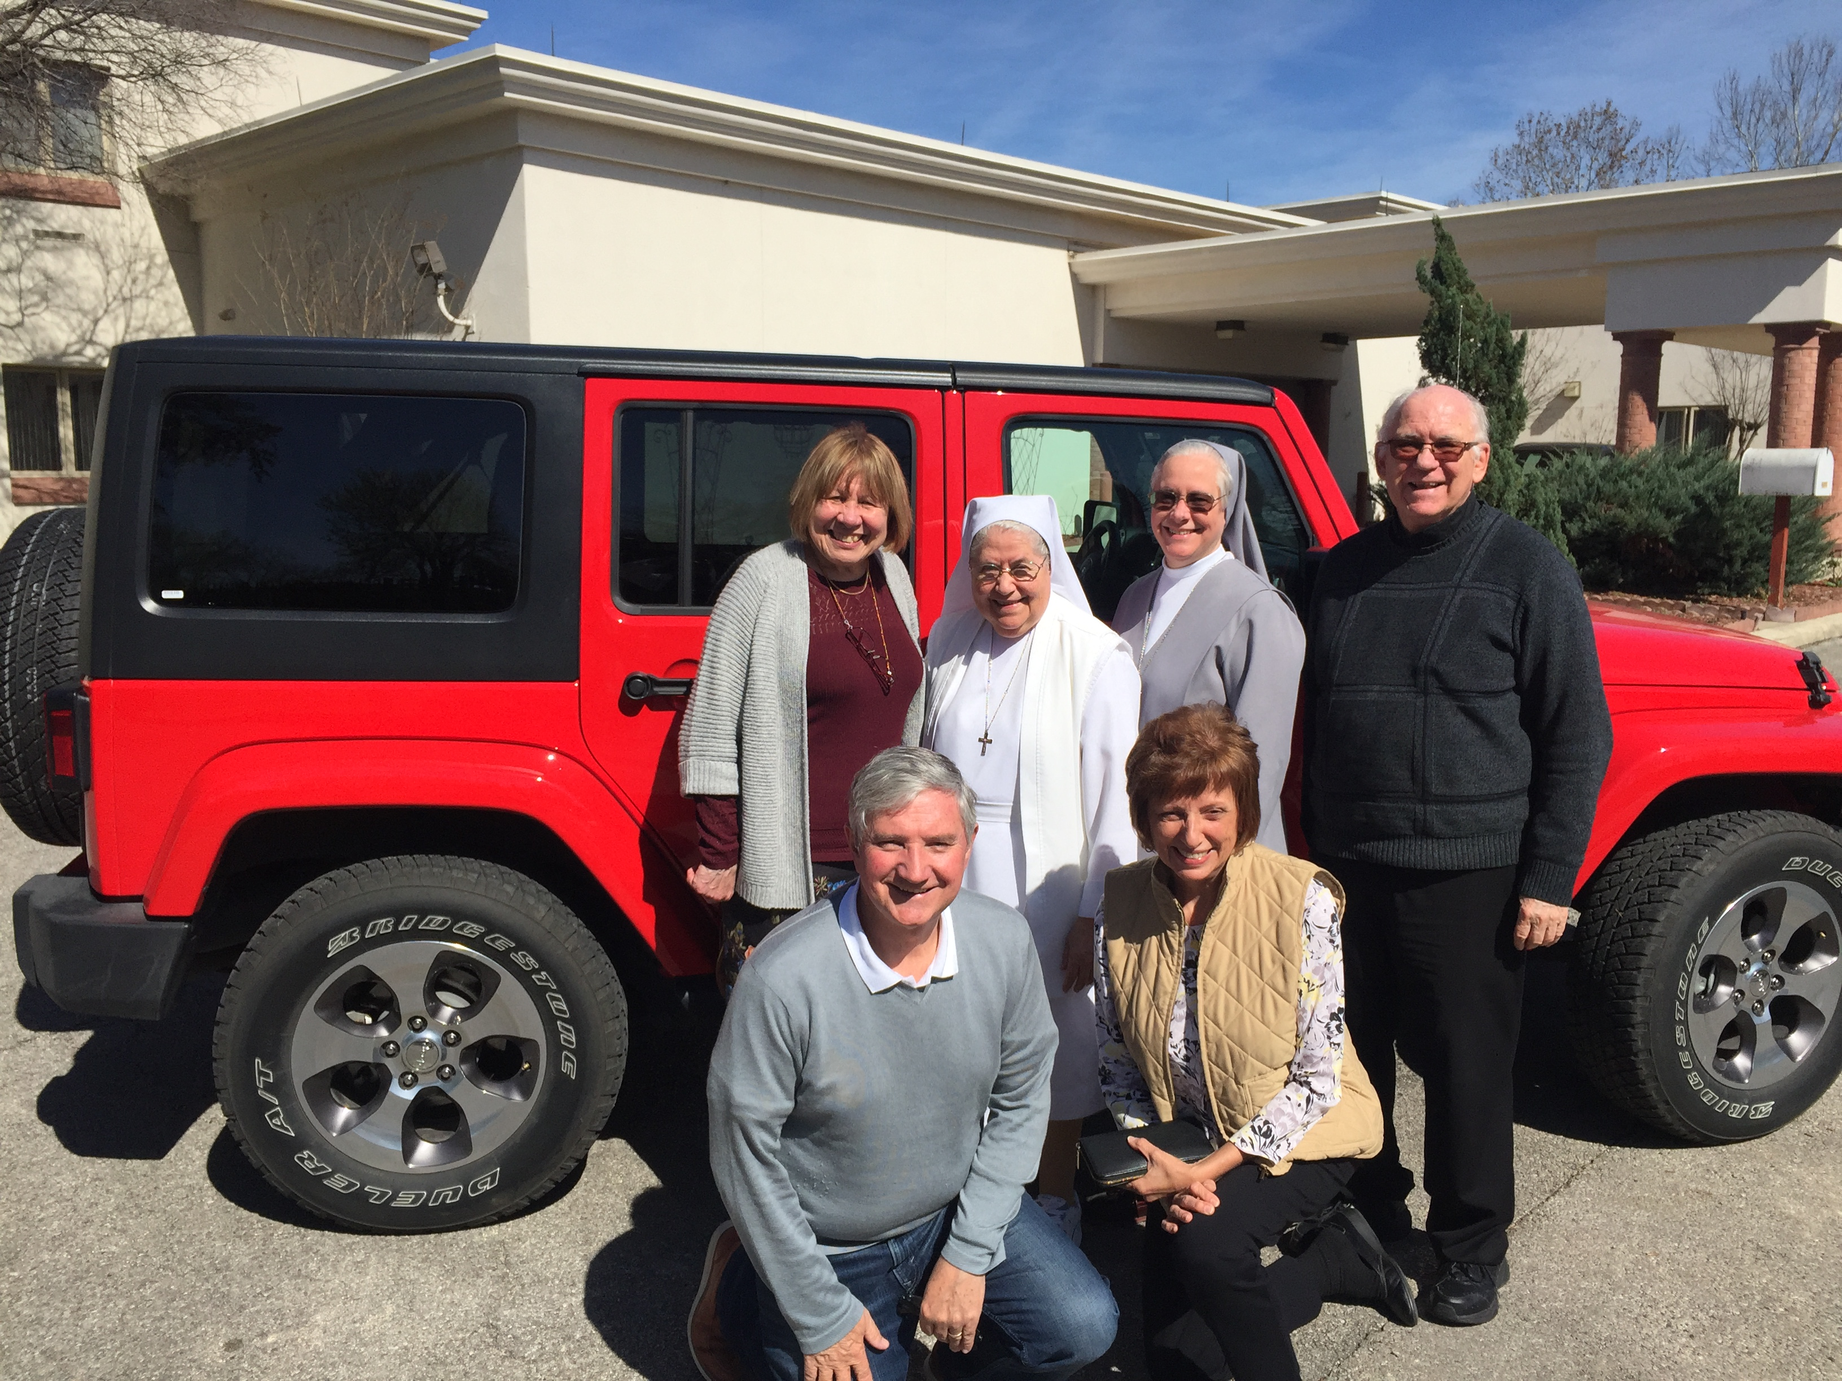
Program Planning Team:
US East
US West
Canada

Slide 8
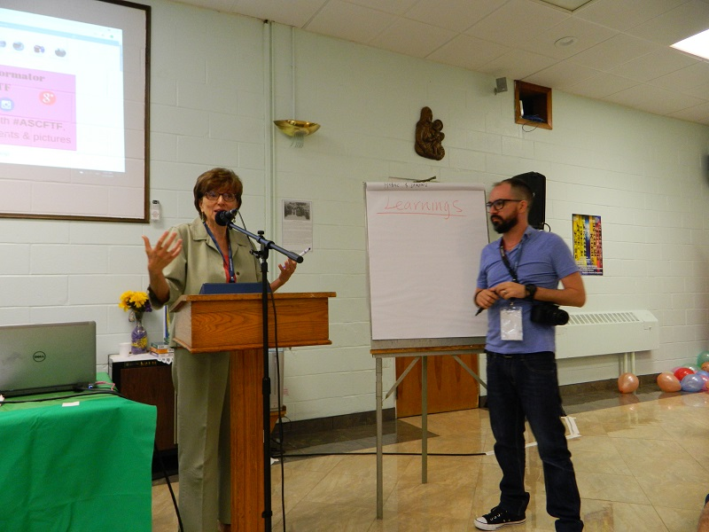
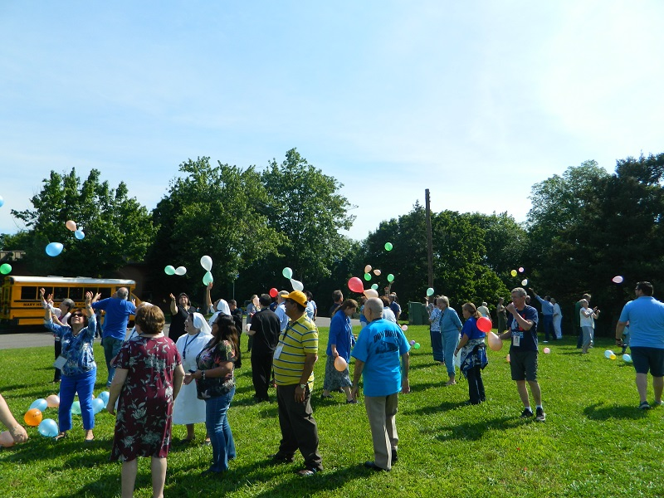
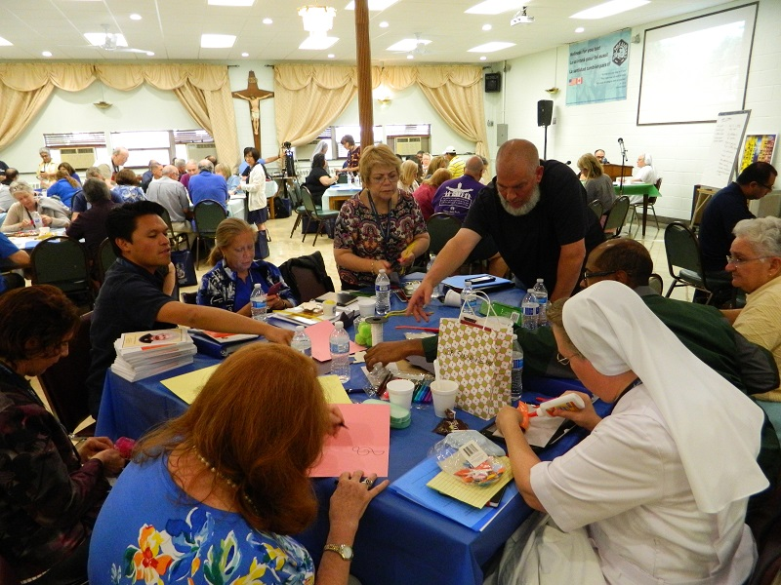
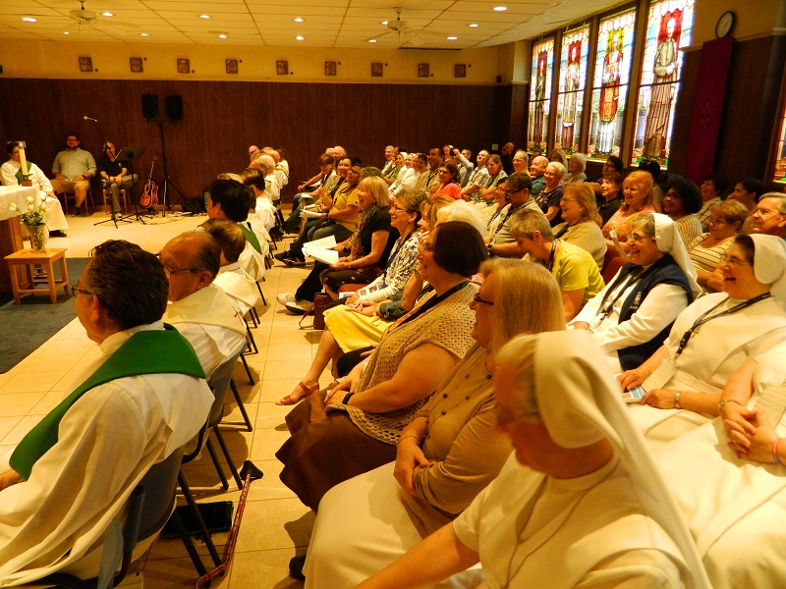
Oratory
Playground – have fun
School – prepare for life
Home – welcomes
Parish – evangelizes

Slide 9
Province level follow-up
to the Forming the Formator Workshop:
Schedule virtual formation meetings on a periodic (bi-monthly basis) for local Center formators and delegates.
2. Develop community within our province on the local level by establishing Center missions.
3. Ensure the continuity of formation throughout the province by establishing a Formation Council at the Province level.
Association of Salesian Cooperators
St. Philip the Apostle Province (SUE)
June 2019

Slide 10
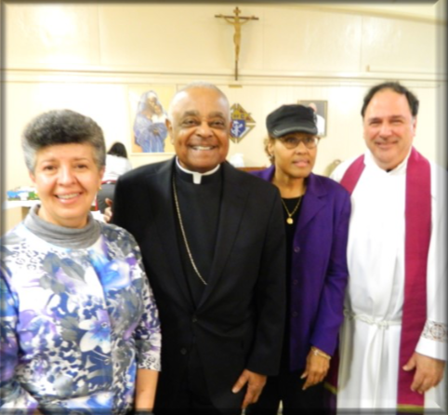
Resources

Slide 11
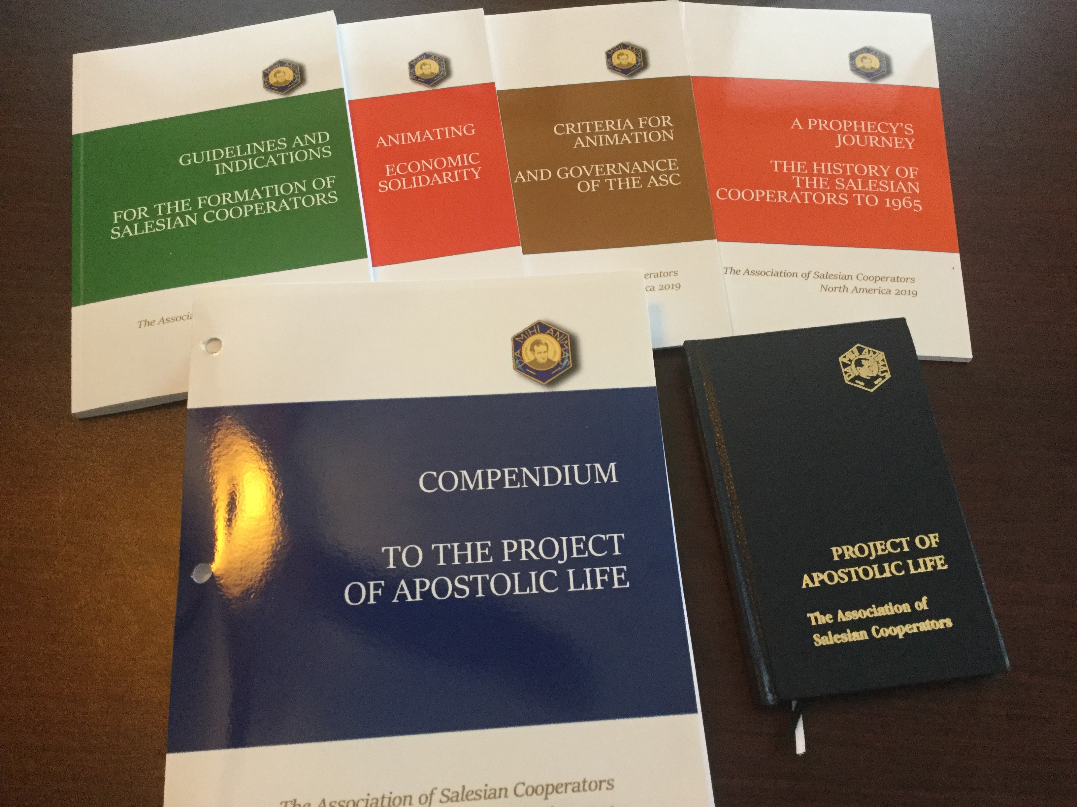
Formation
Documents

Slide 12

Formation Study Resources
Developed in US/Canada
https://donboscosalesianportal.org/
The Compendium for
Salesian Cooperator Formators
Discerning the Call
Manual for Initial Formation

Slide 13
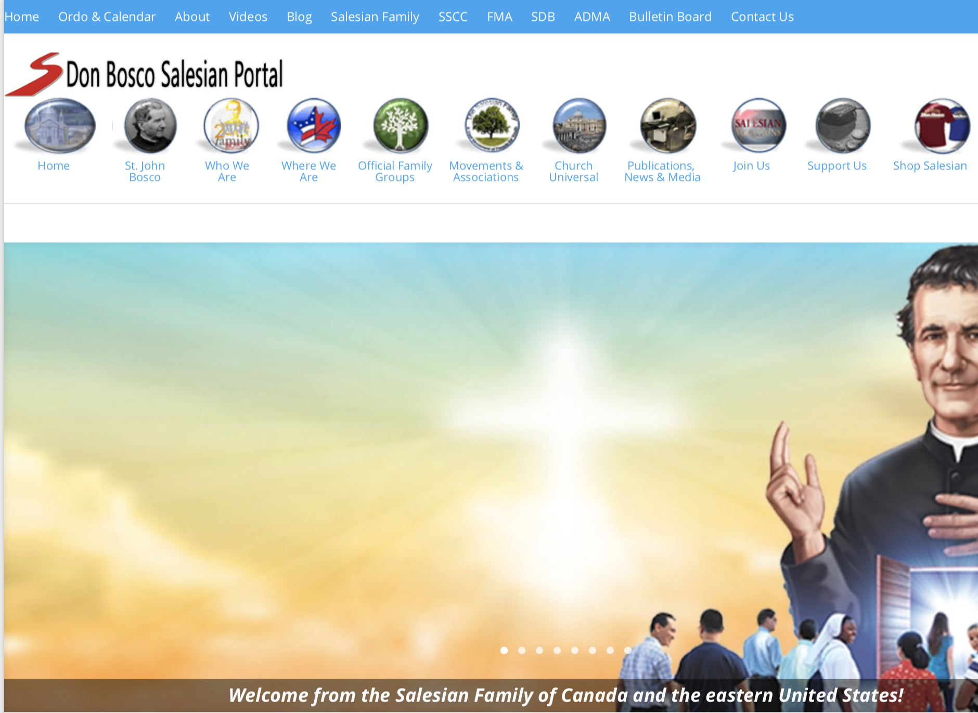

Slide 14


Slide 15
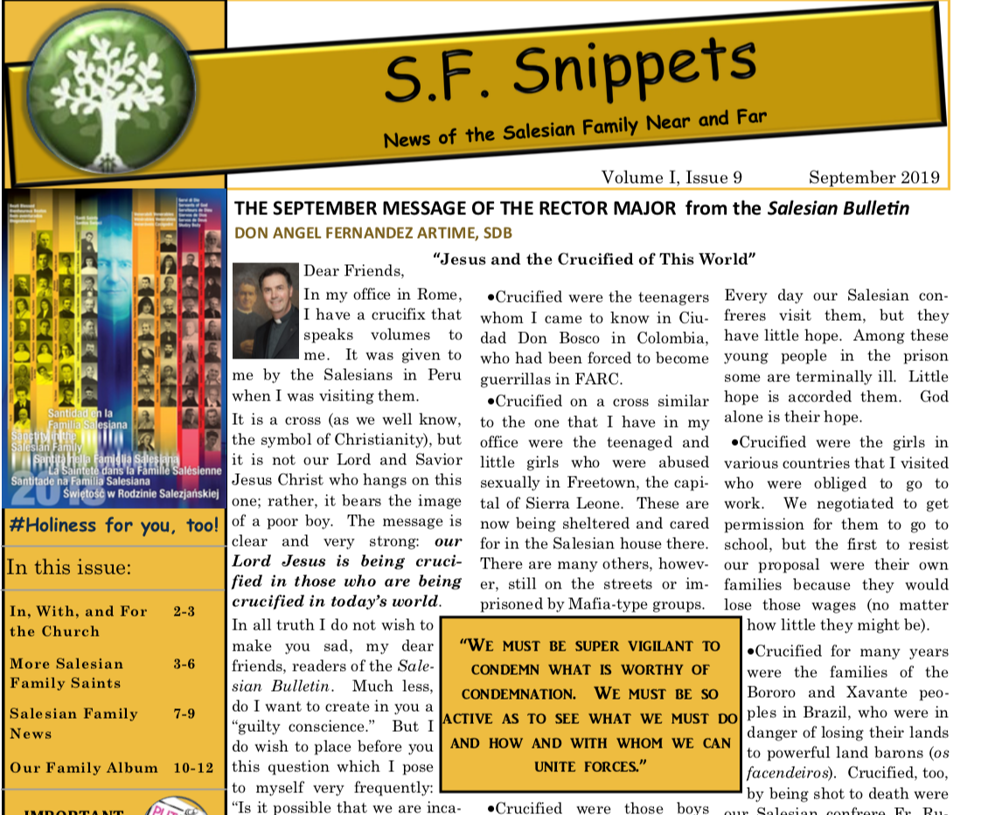

Slide 16
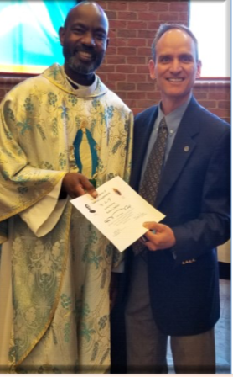

Association of Salesian Cooperators
St. Philip the Apostle Province (SUE)
Association of Salesian Cooperators
St. Philip the Apostle Province (SUE)
June 2019
August 2017

Slide 17
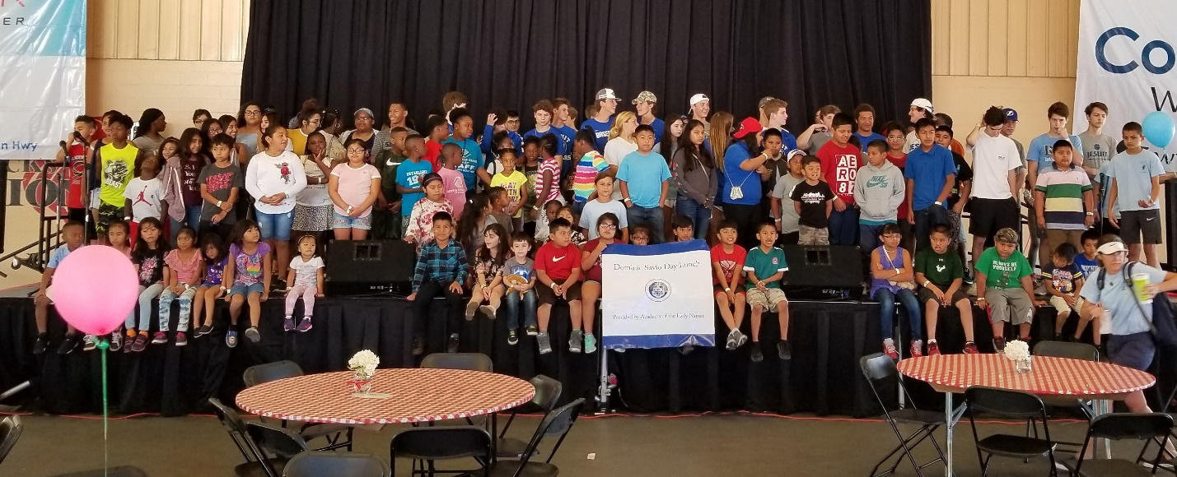
APOSTOLATES & ACTIVE LIFE
Middle/High School Service Group “Sean Devereaux Club” & Christ the King Salesian Cooperators host migrant family children at the “5th Annual Dominic Savio Carnival Day”, (sponsored over 175). Tampa, Florida.
Association of Salesian Cooperators
St. Philip the Apostle Province (SUE)
June 2019

Slide 18
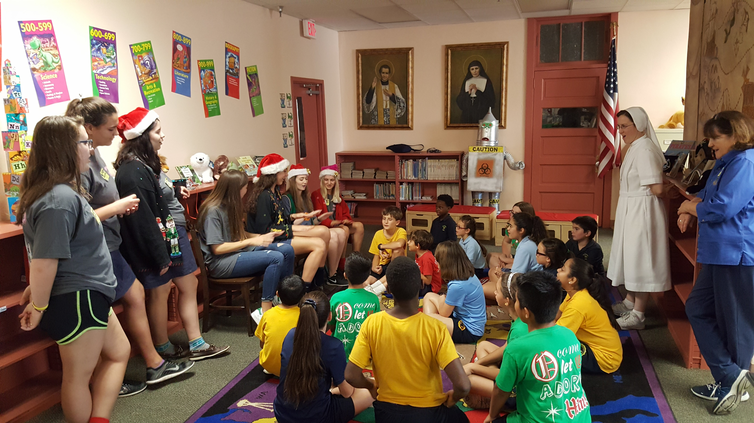
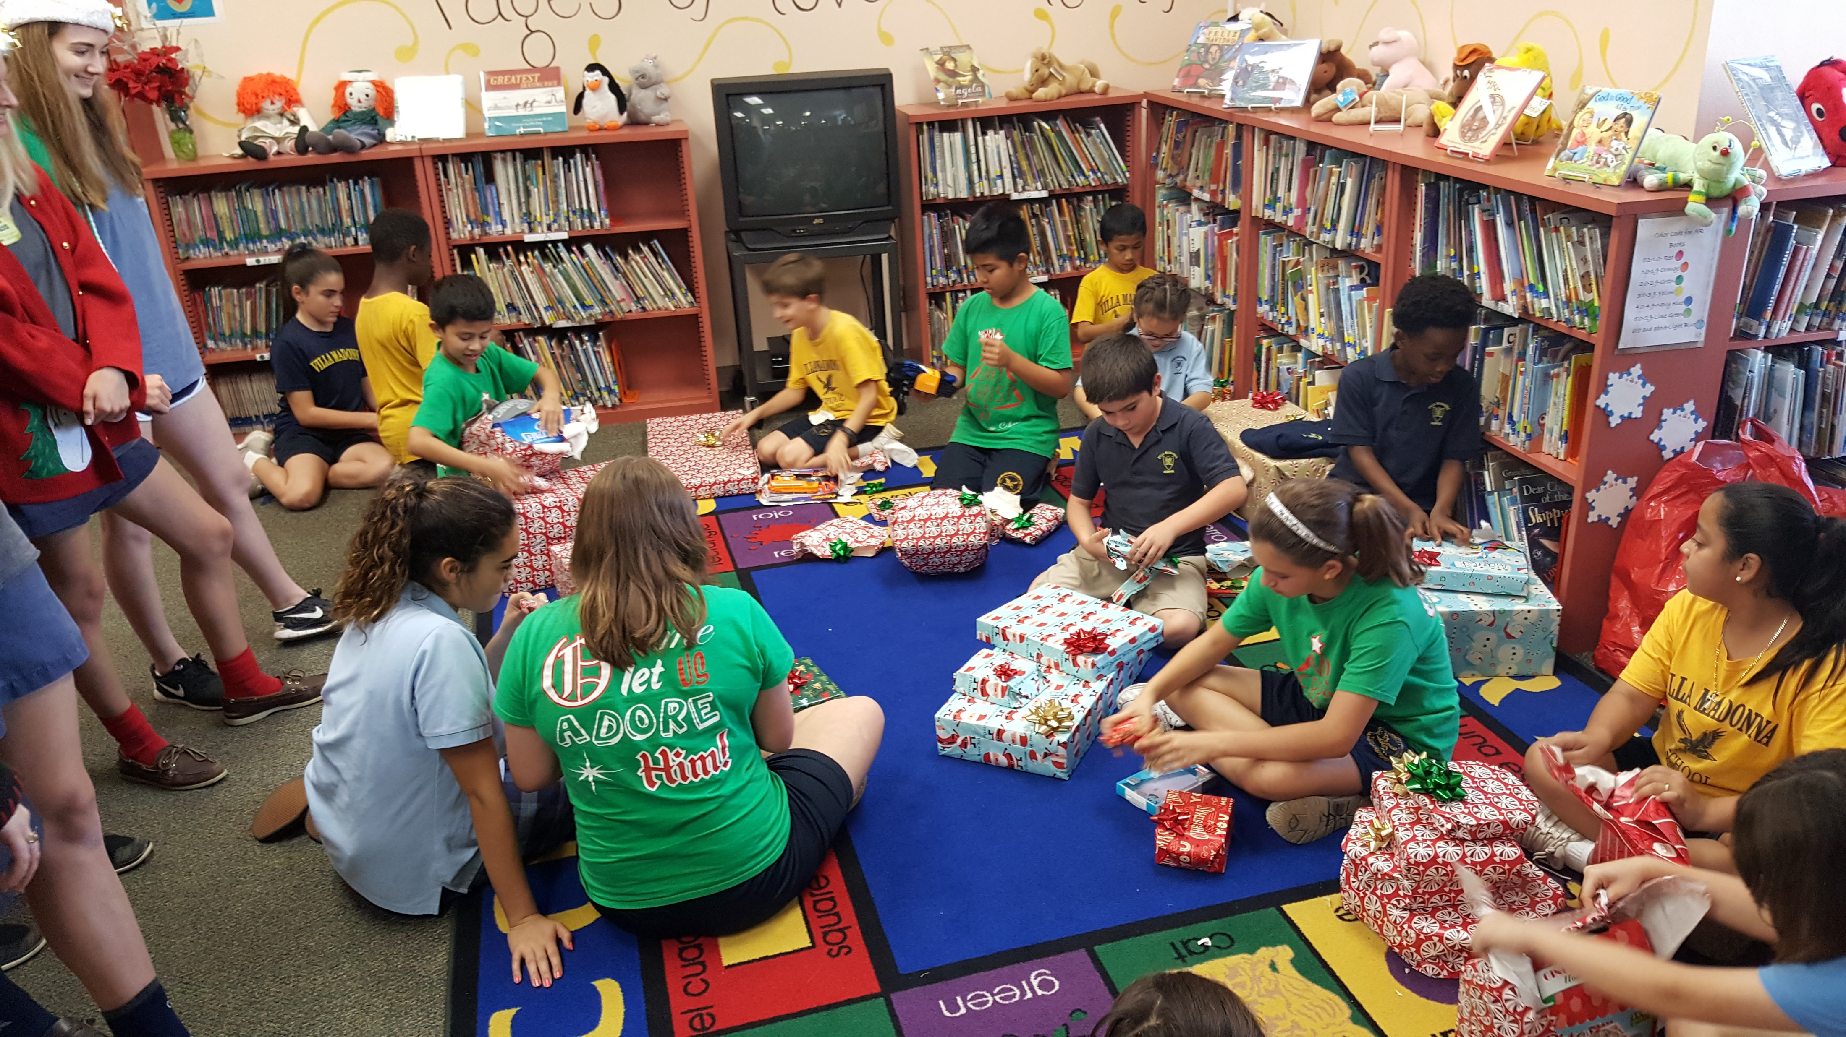
Christ the King Center Tampa
Cooperator liaison high school group having
Christmas party for challenged youth
Association of Salesian Cooperators
St. Philip the Apostle Province (SUE)
June 2019

Slide 19
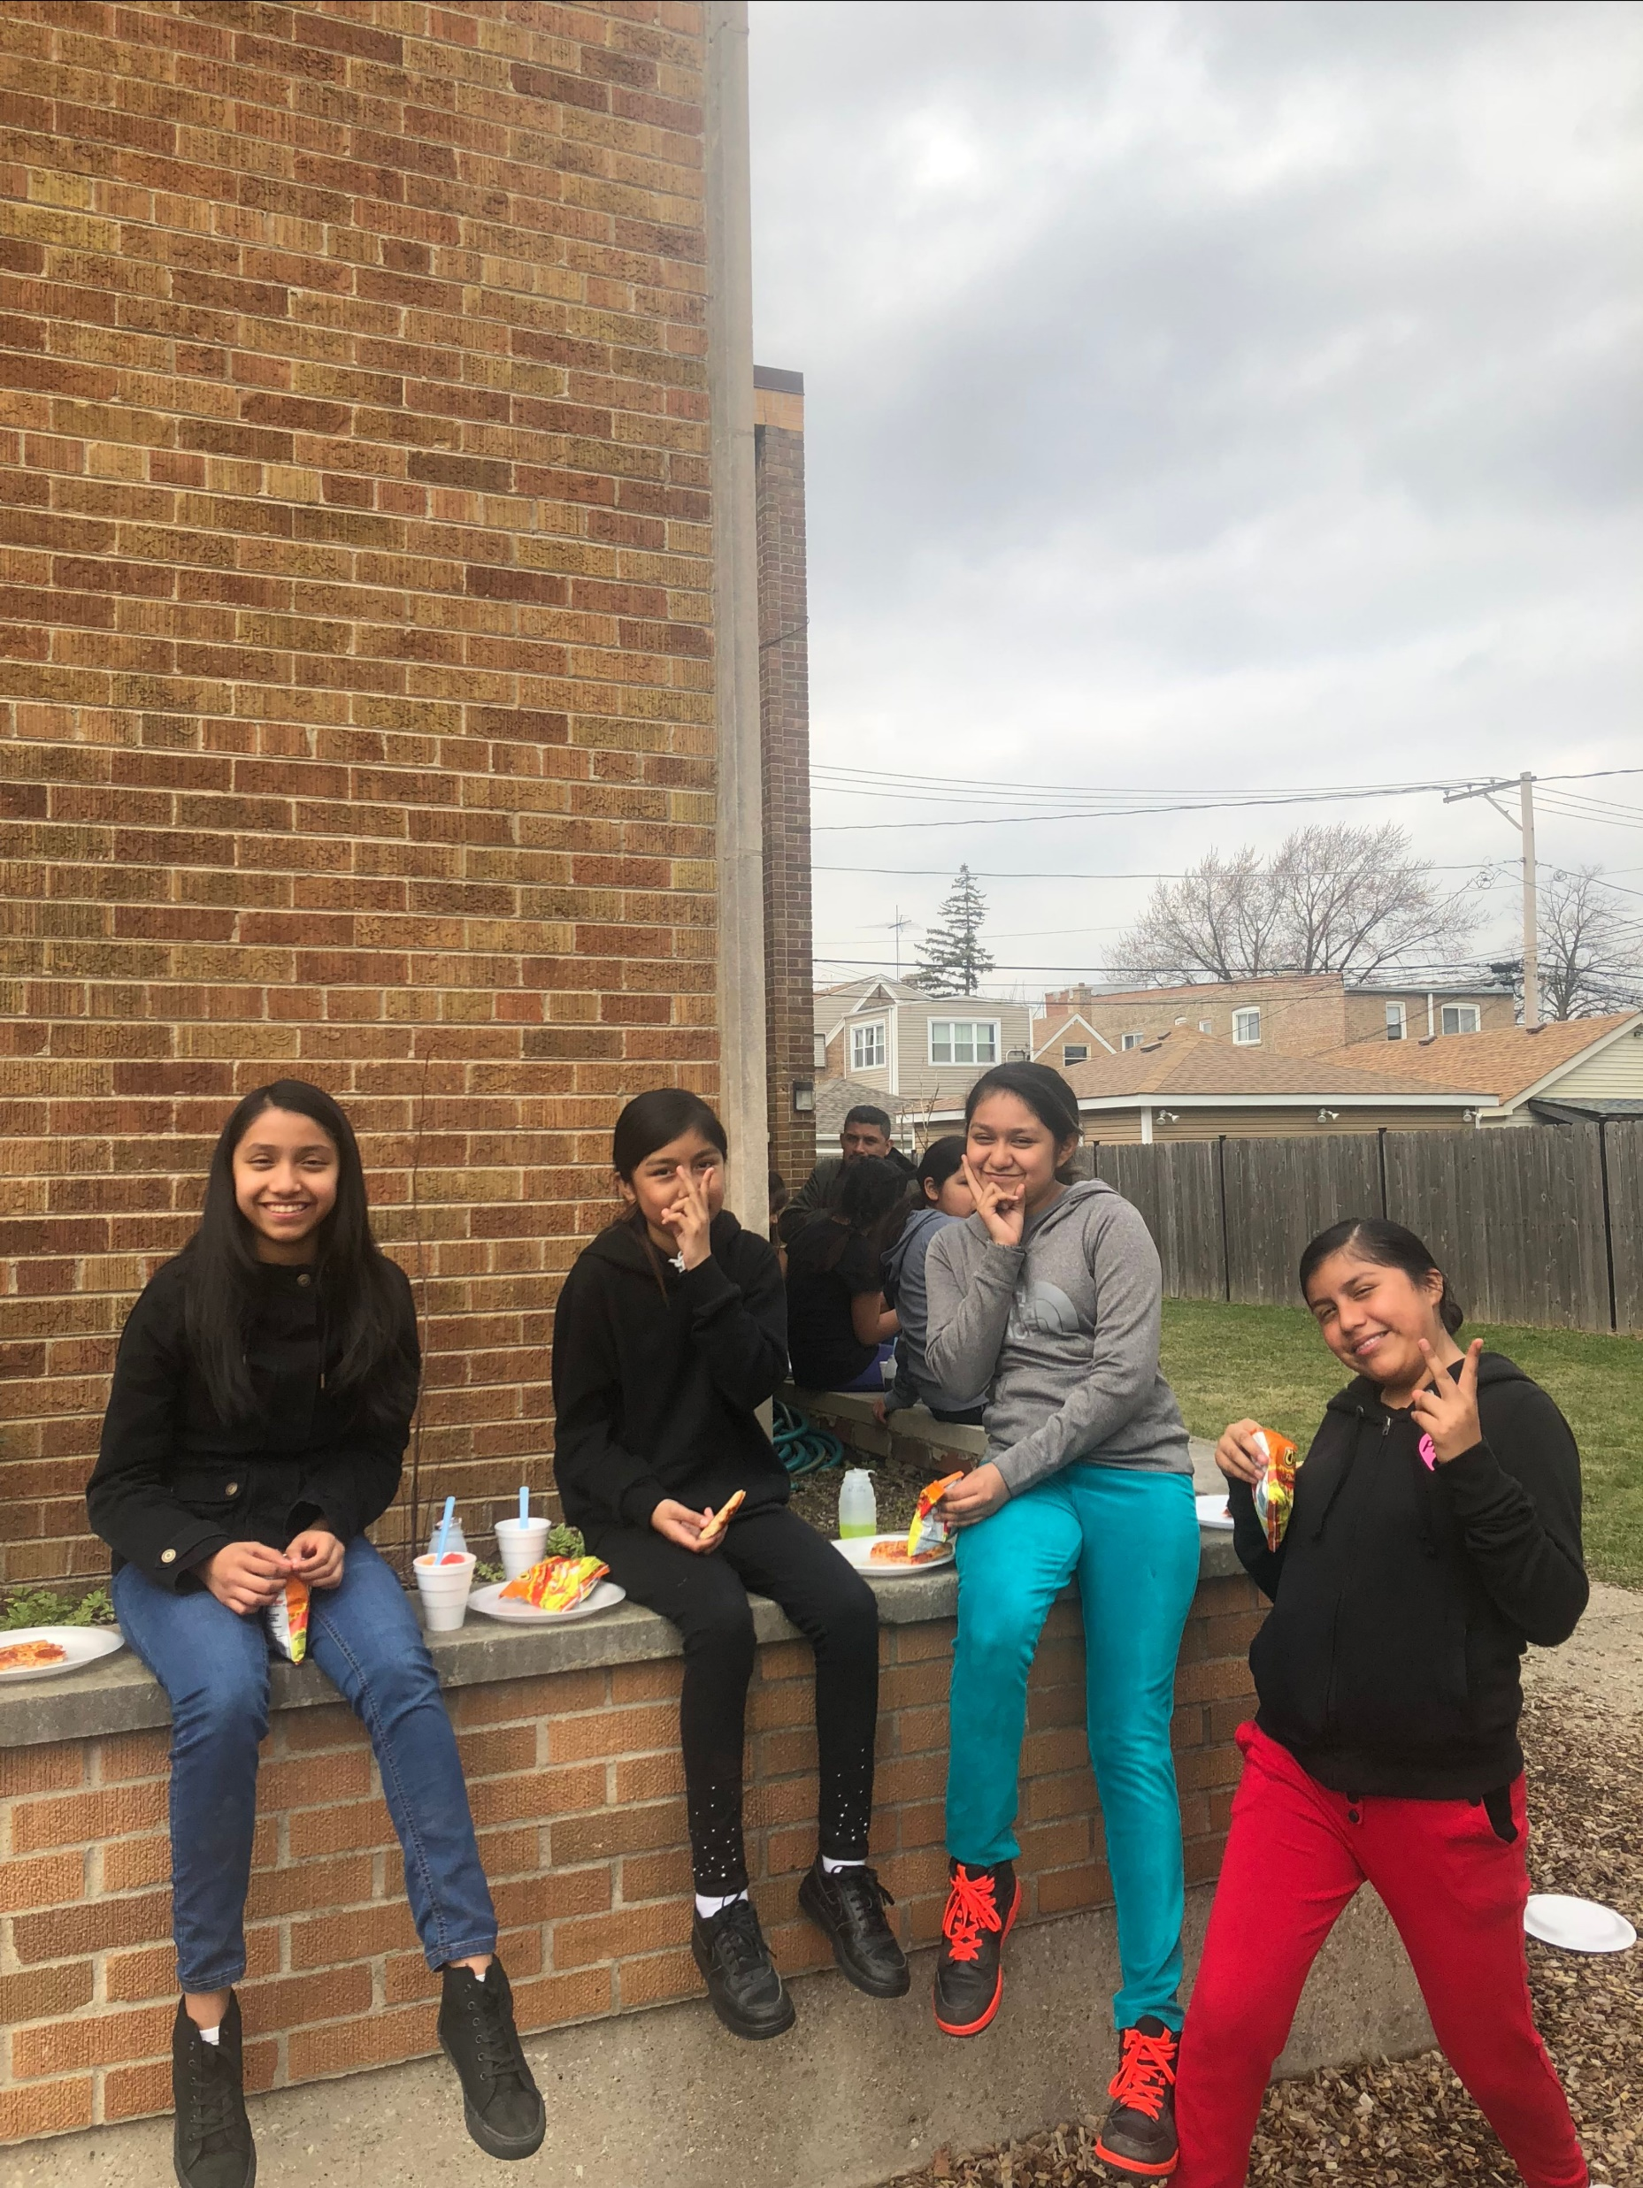
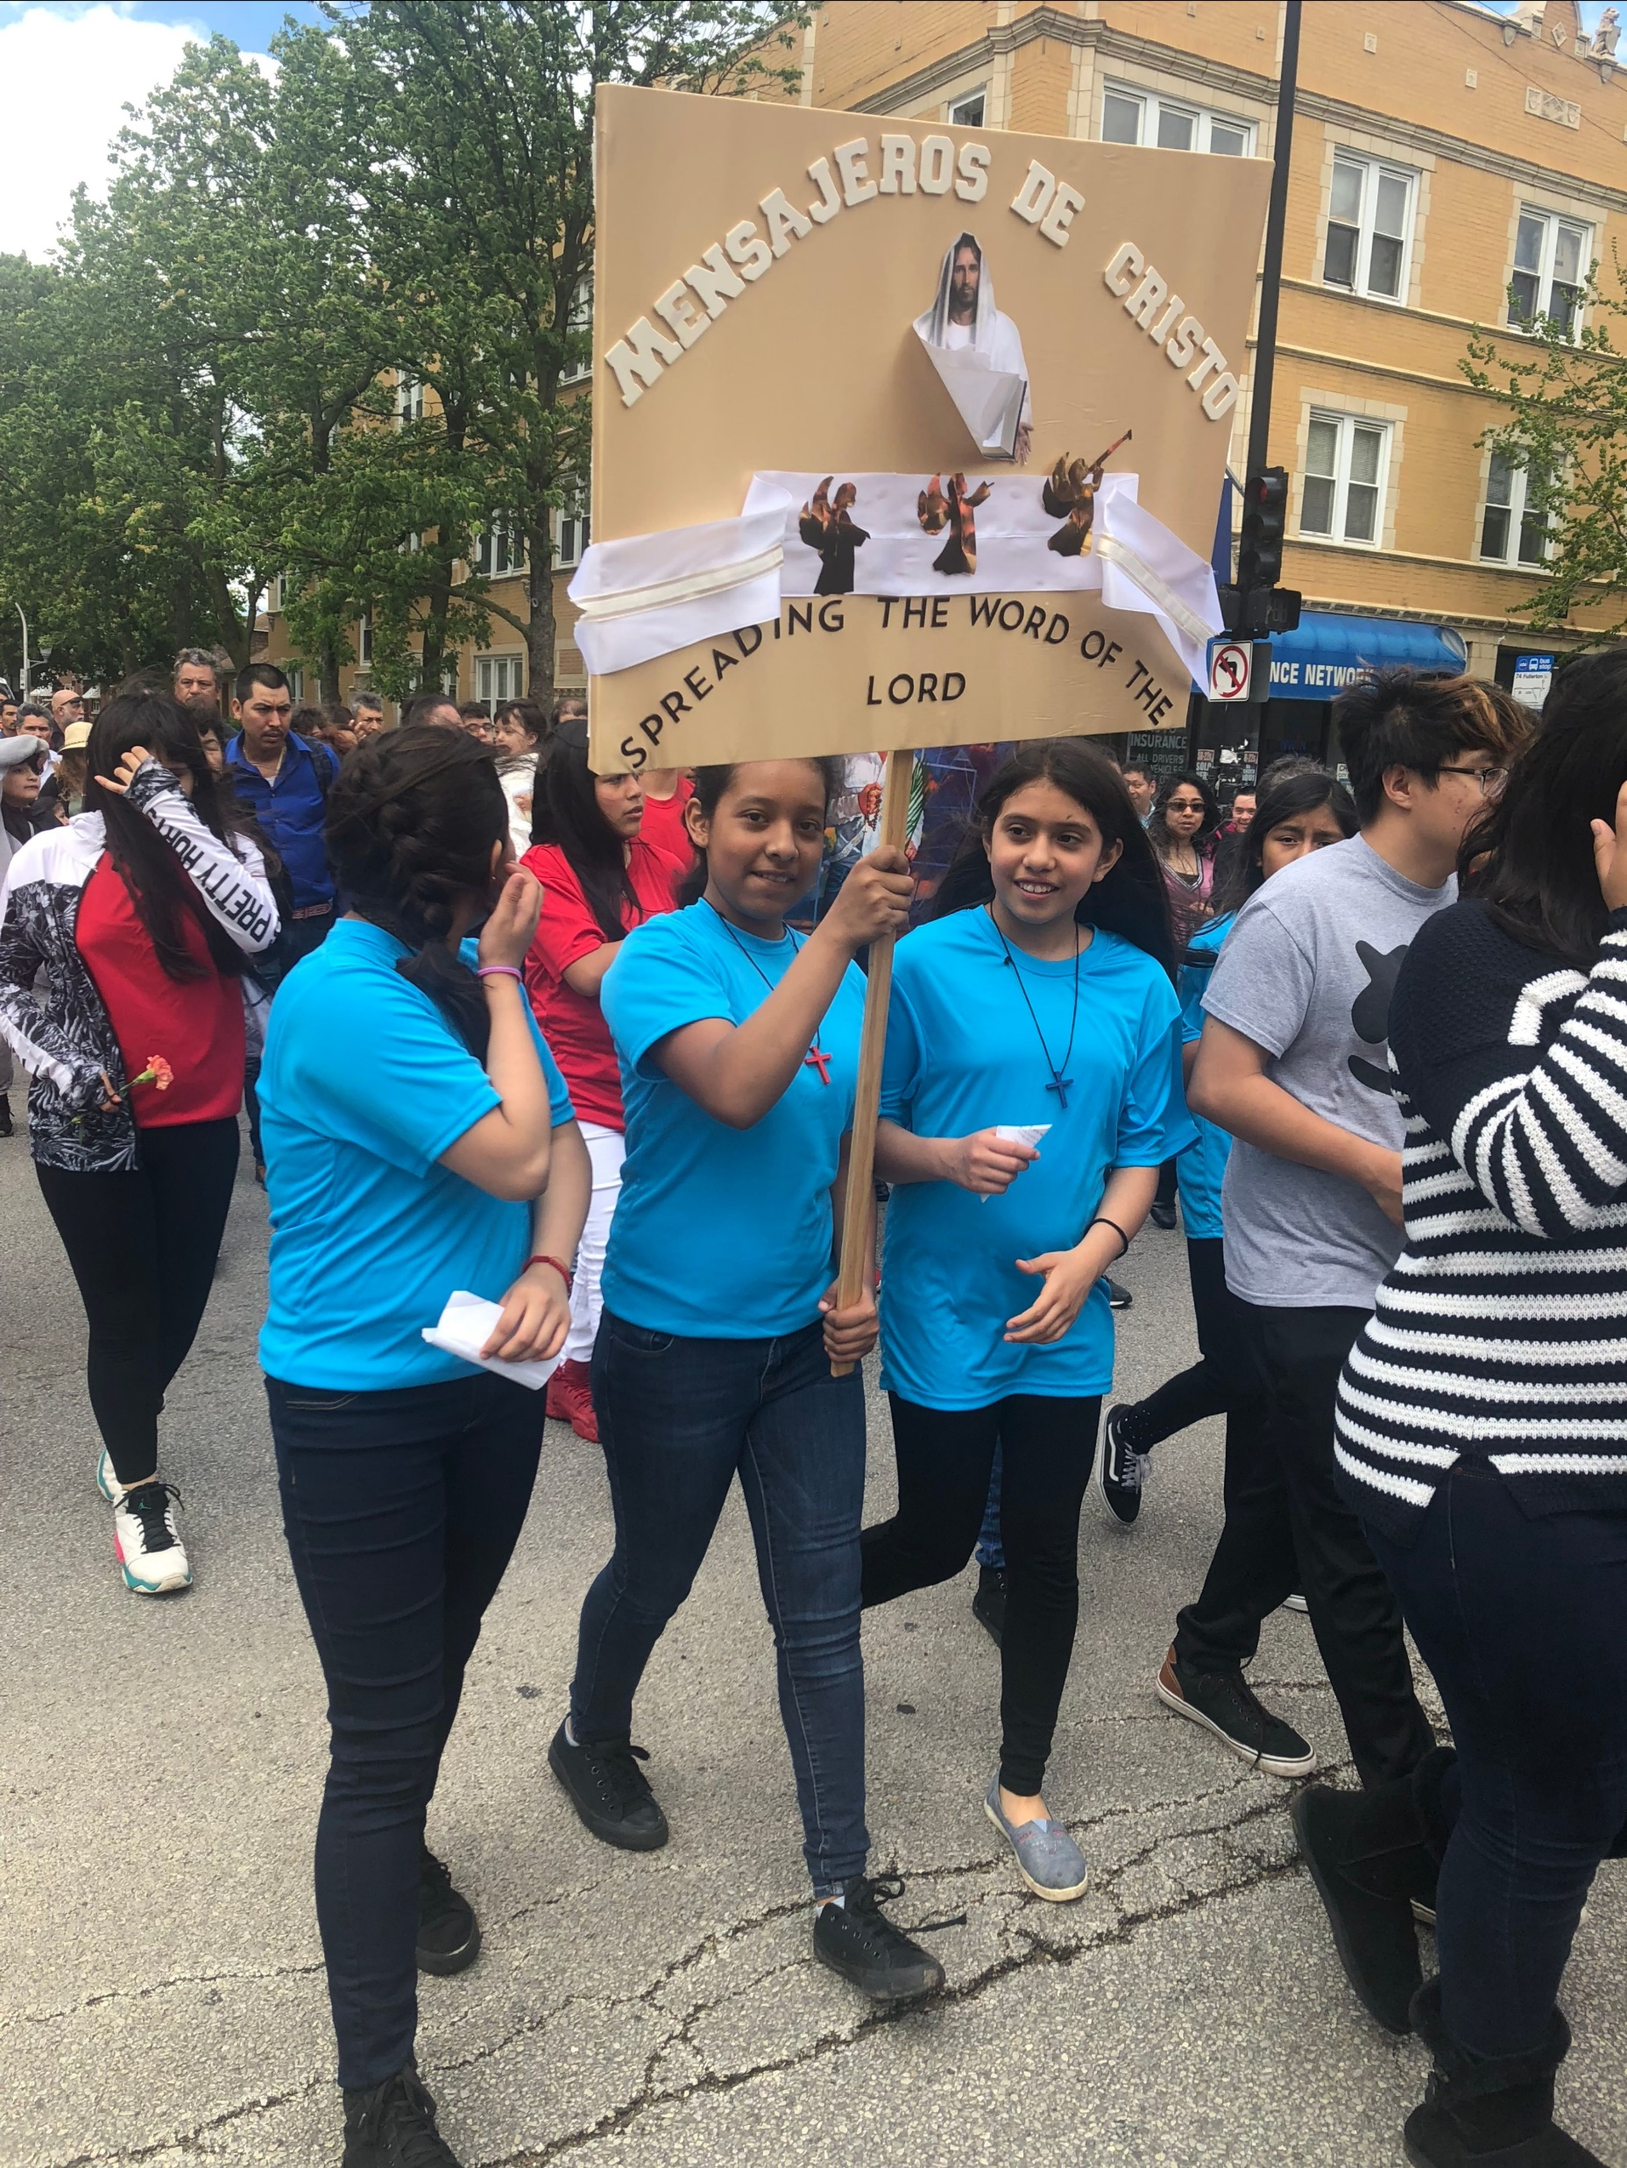
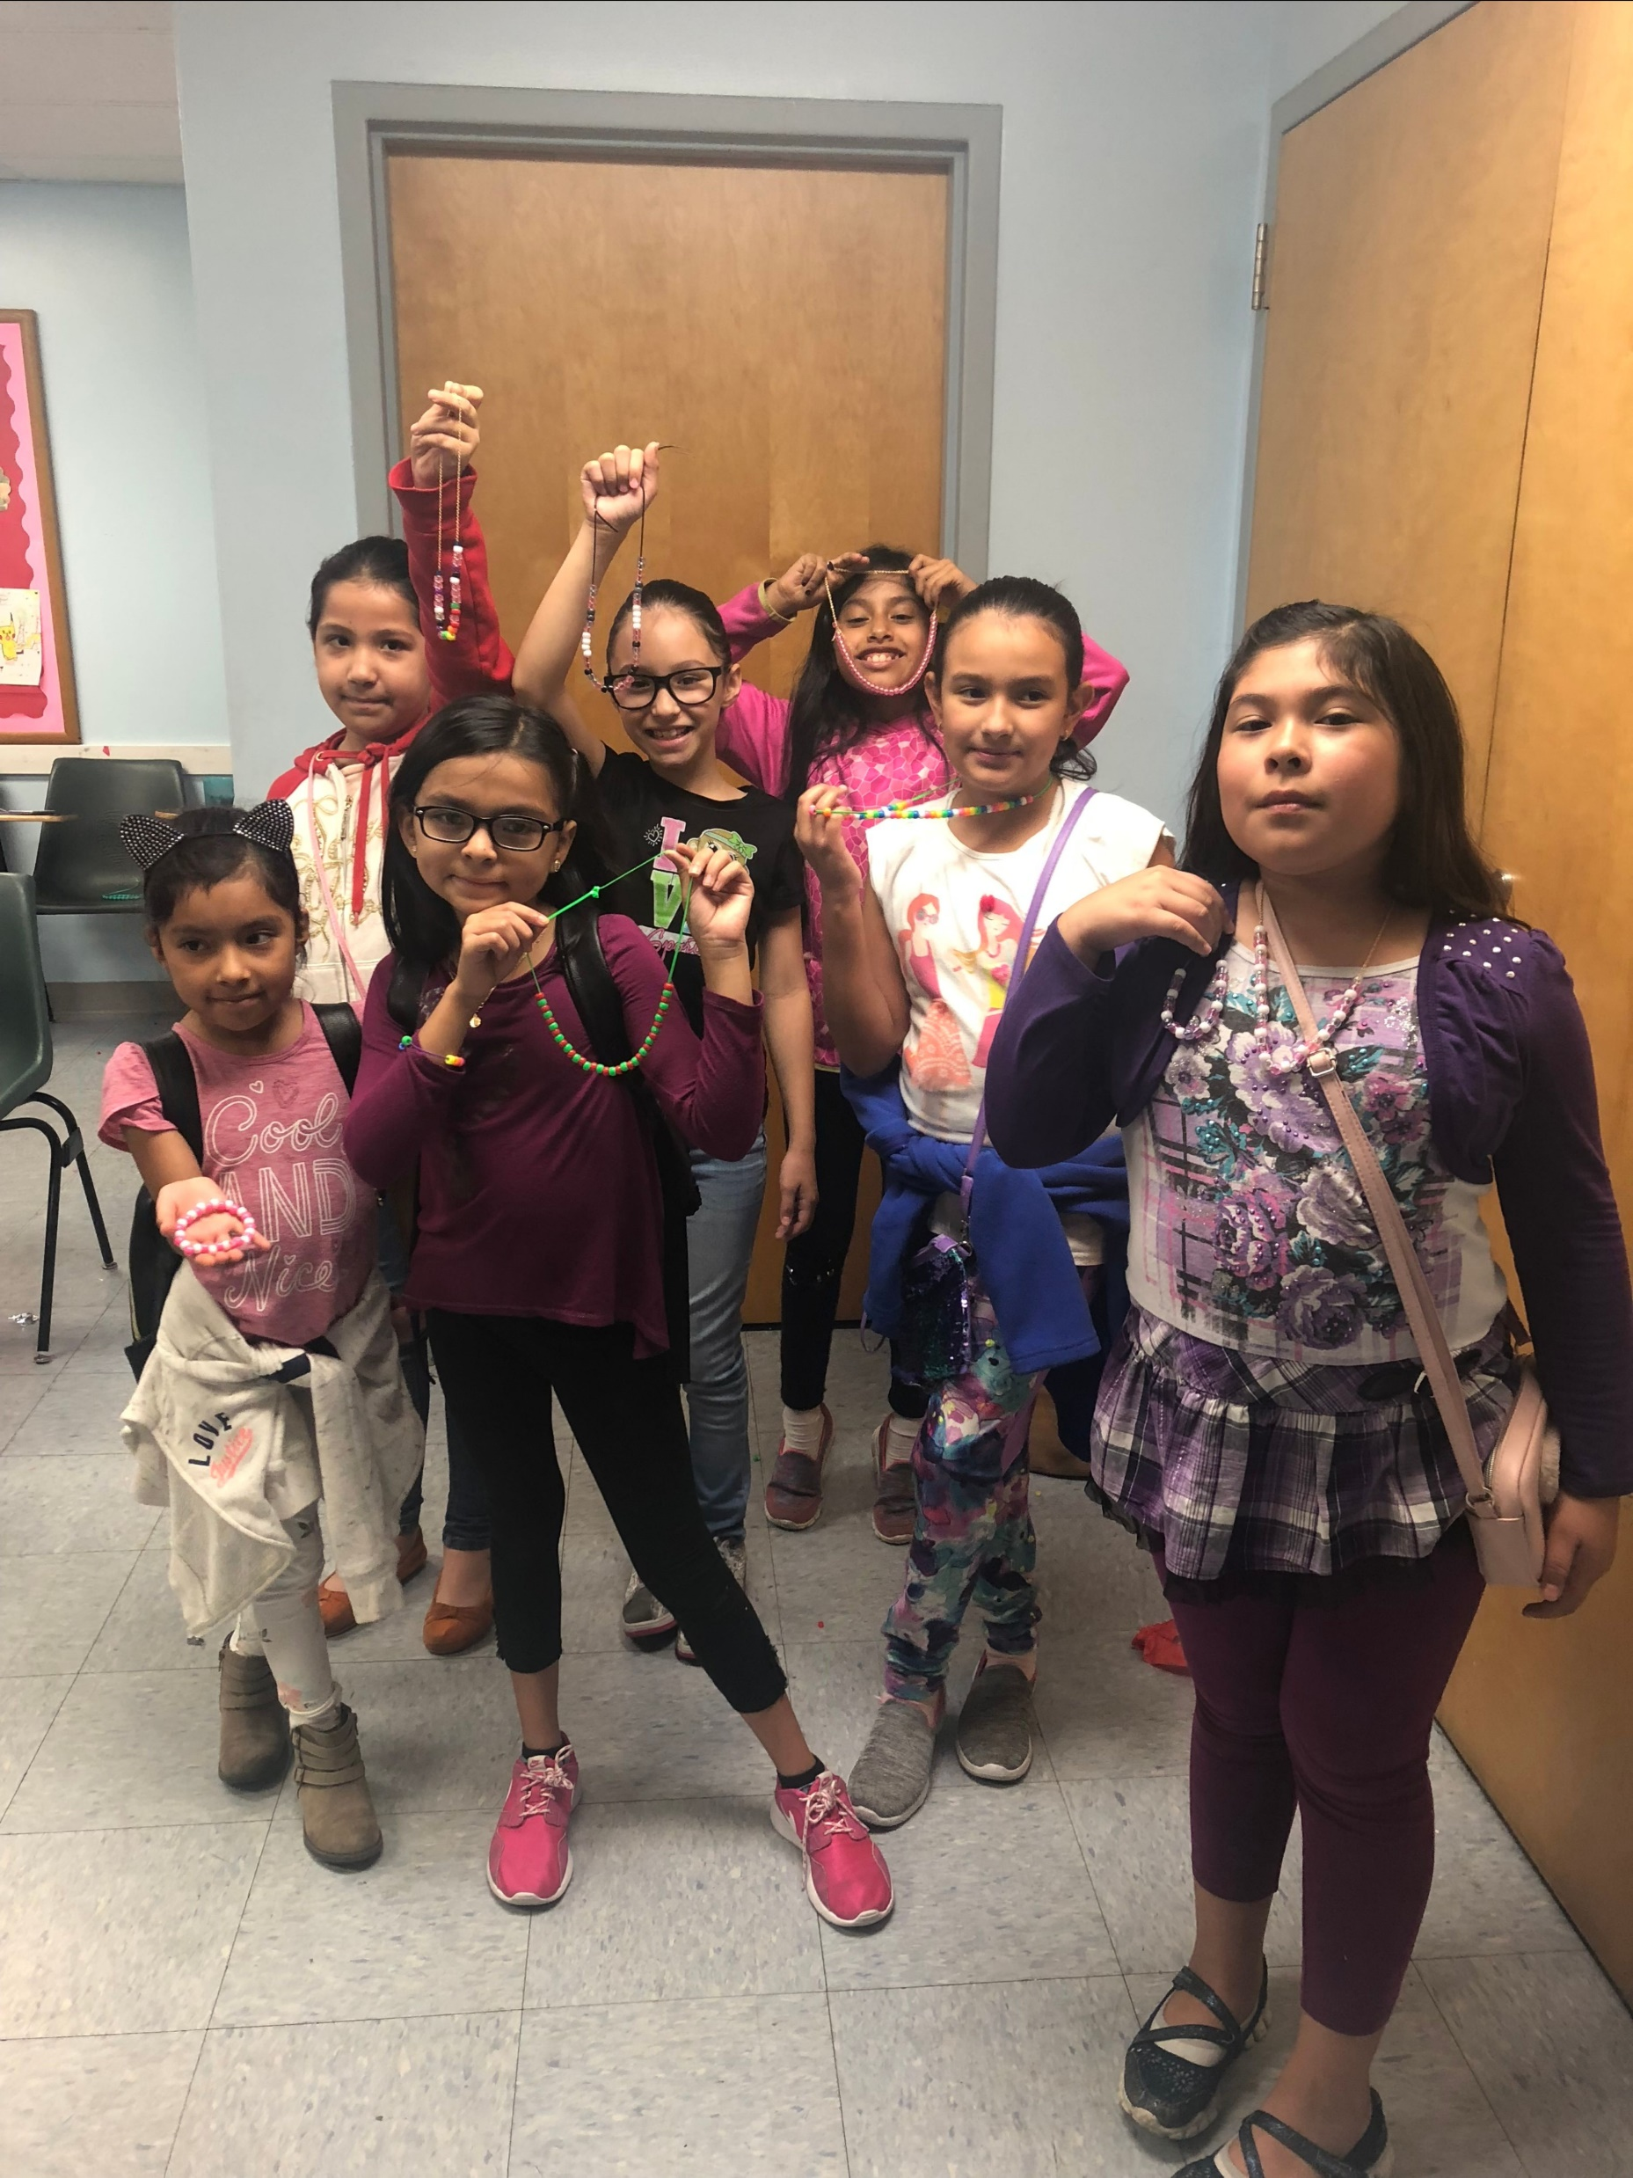
Bl. Artemide Zatti Center (Chicago)
St. John Bosco Oratory
Association of Salesian Cooperators
St. Philip the Apostle Province (SUE)
June 2019

Slide 20
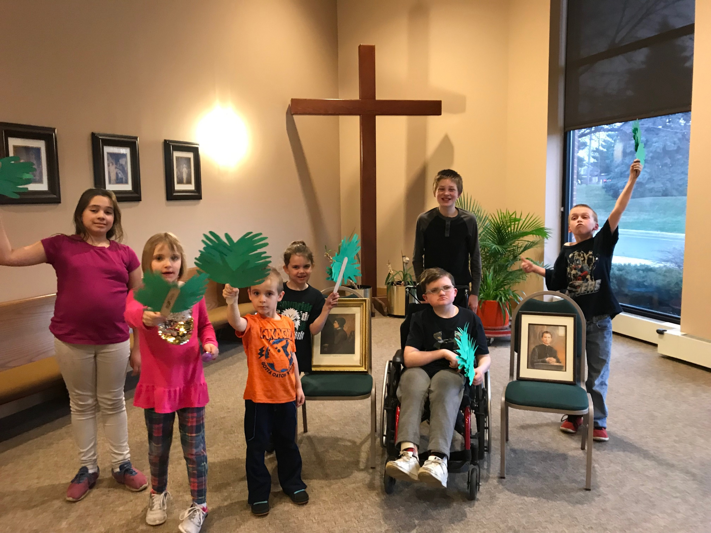
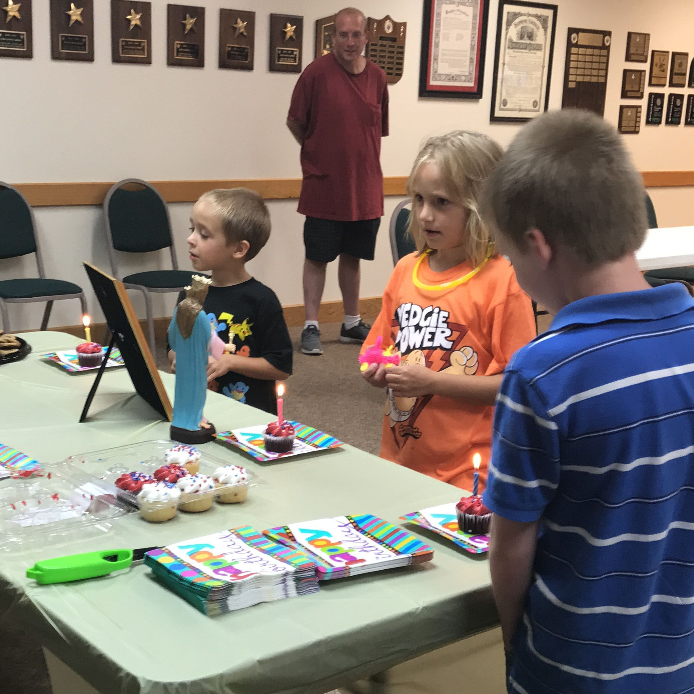
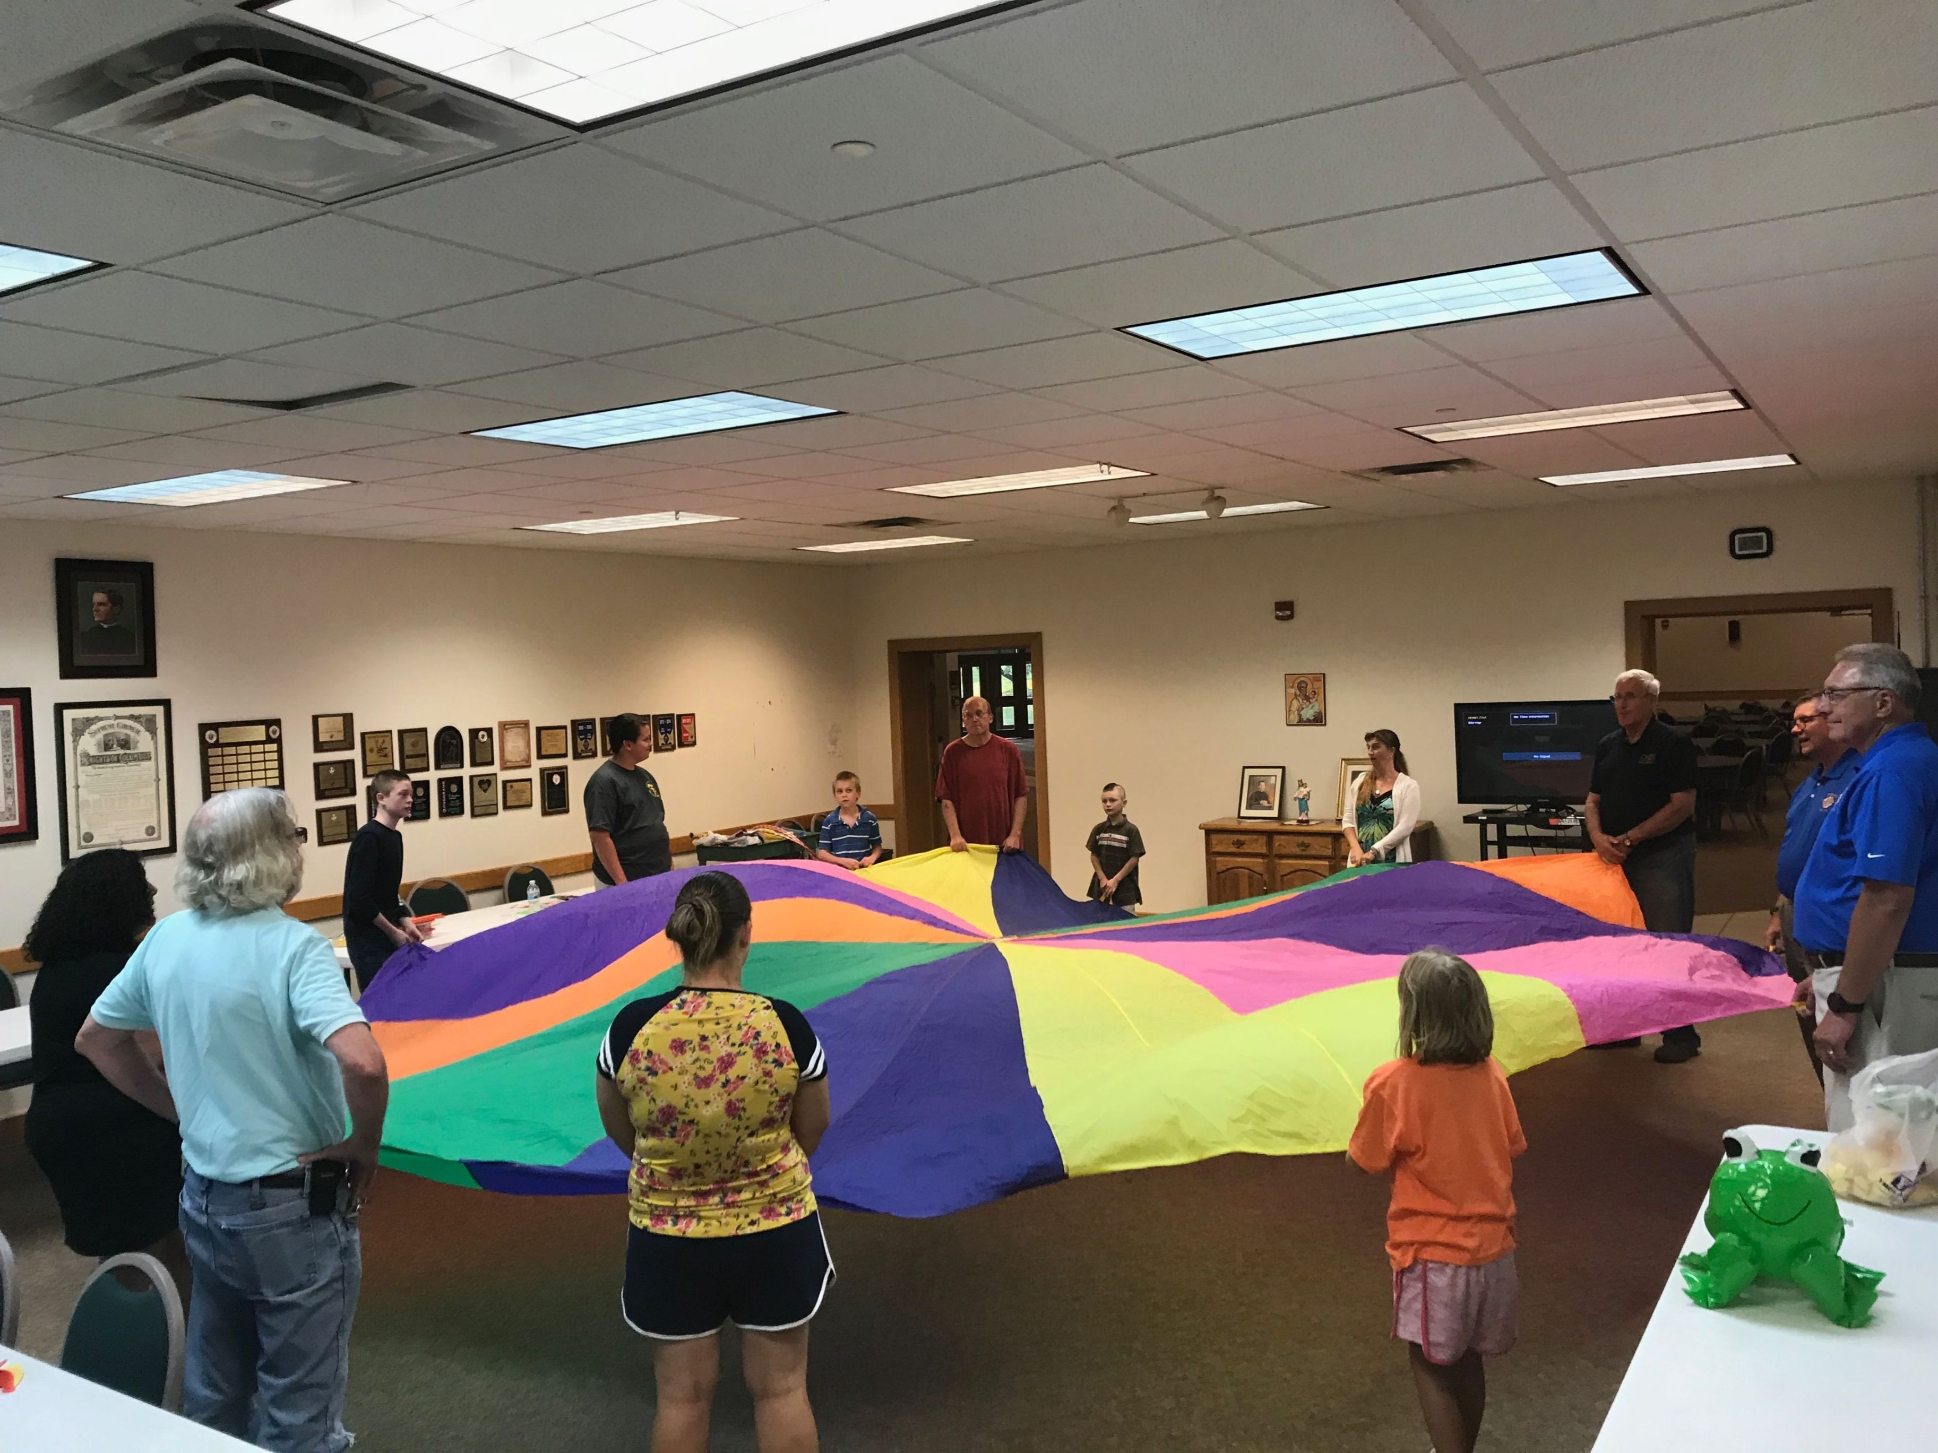
St. Mary Mazzarello Center (St. Charles, ILLINOIS)
Bosco Youth Education program for children with special needs
Celebrating St. John Bosco's Birthday
Association of Salesian Cooperators
St. Philip the Apostle Province (SUE)
June 2019

Slide 21
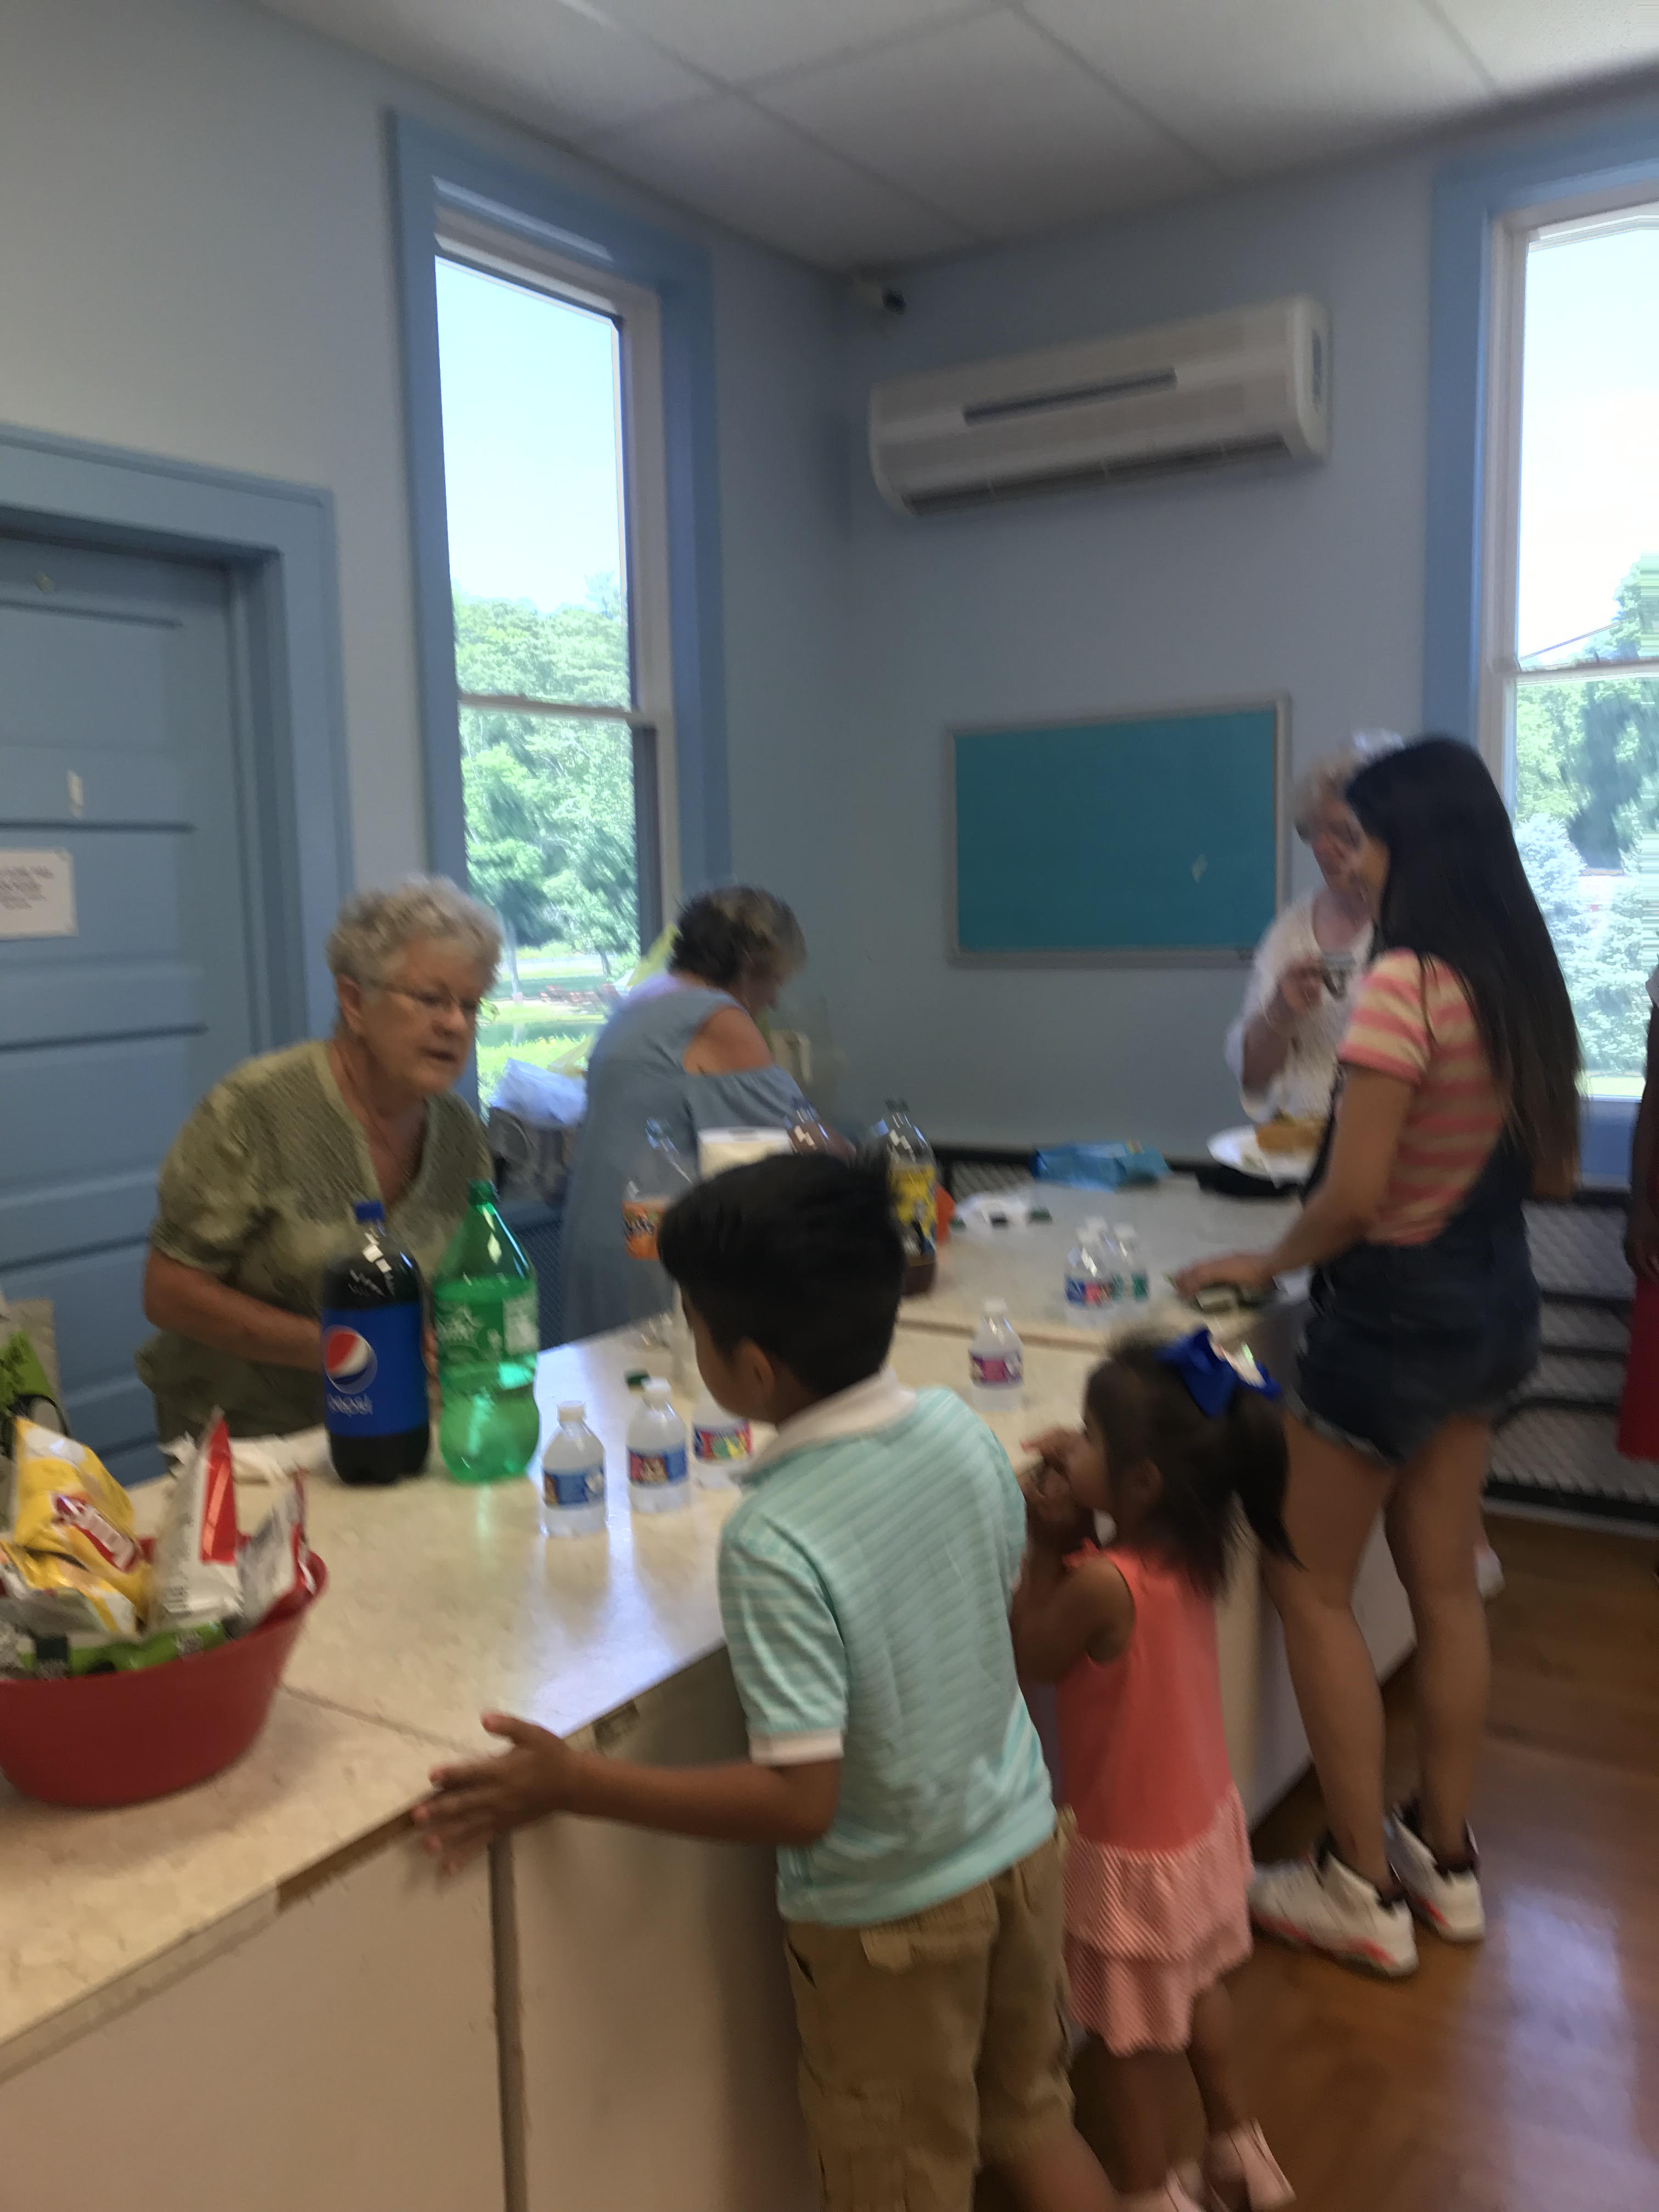
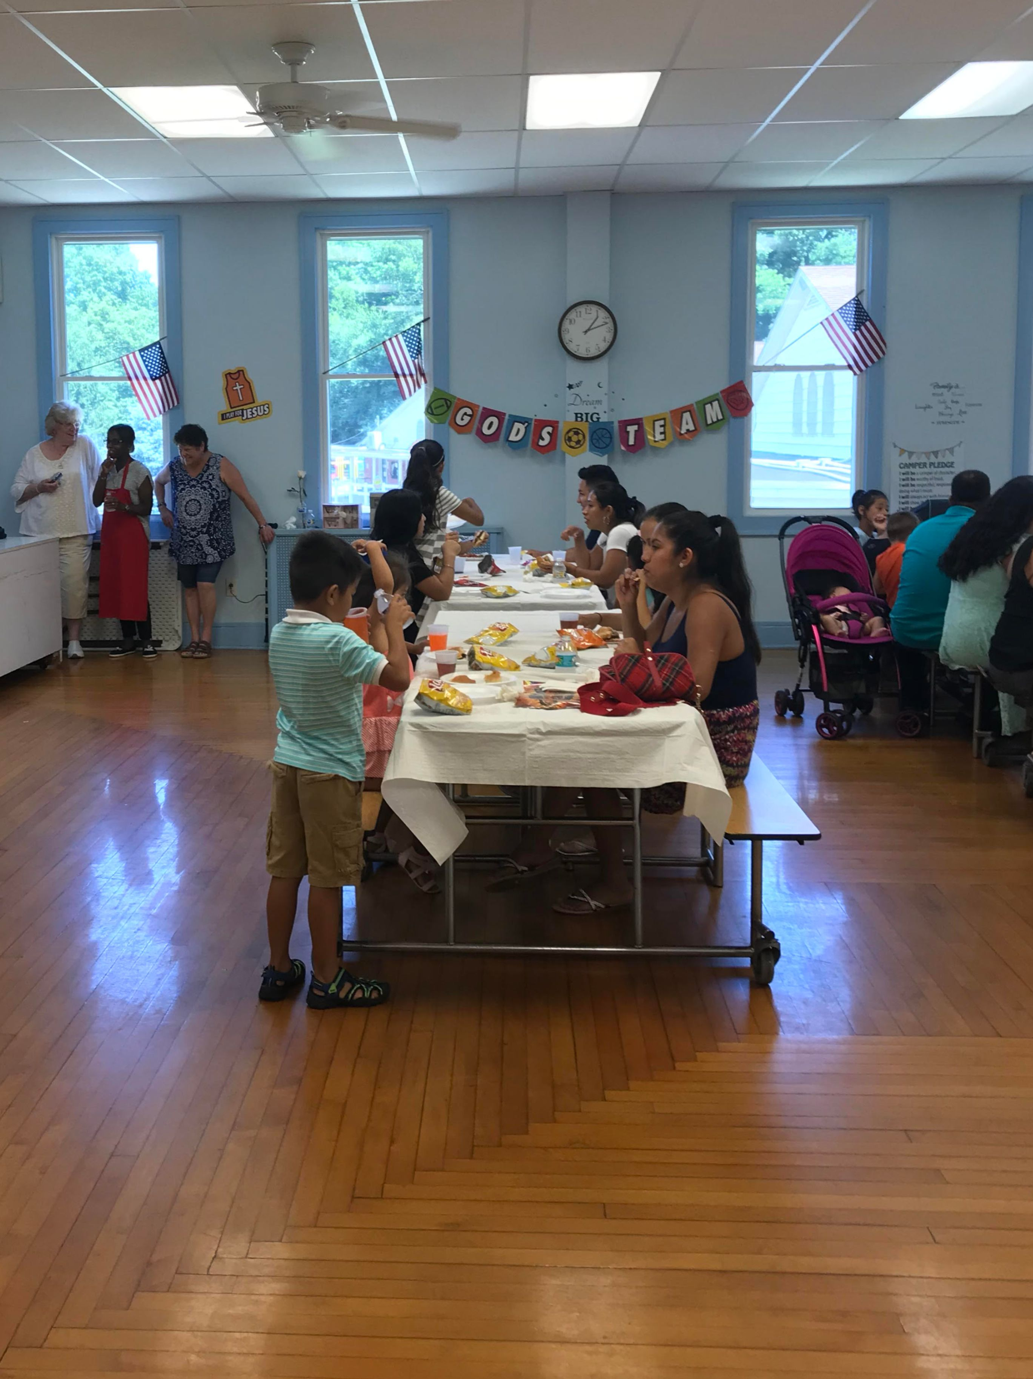
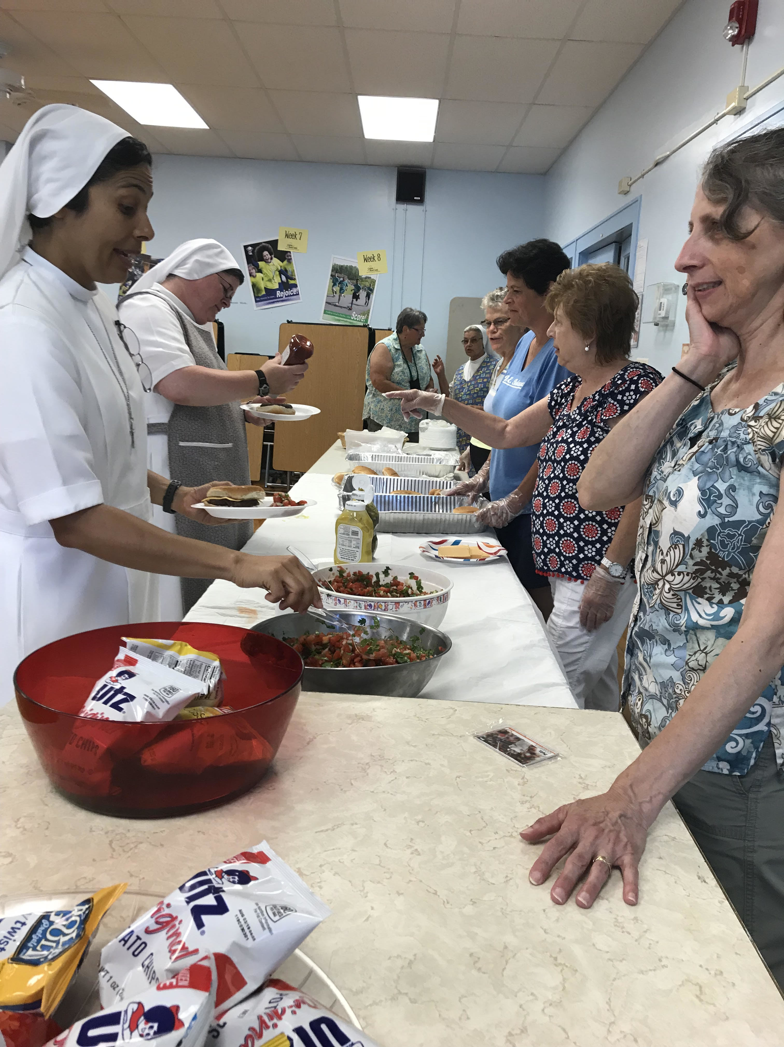
Newton, New Jersey Center
Migrant Picnic
Migrant Picnic
Association of Salesian Cooperators
St. Philip the Apostle Province (SUE)
June 2019

Slide 22
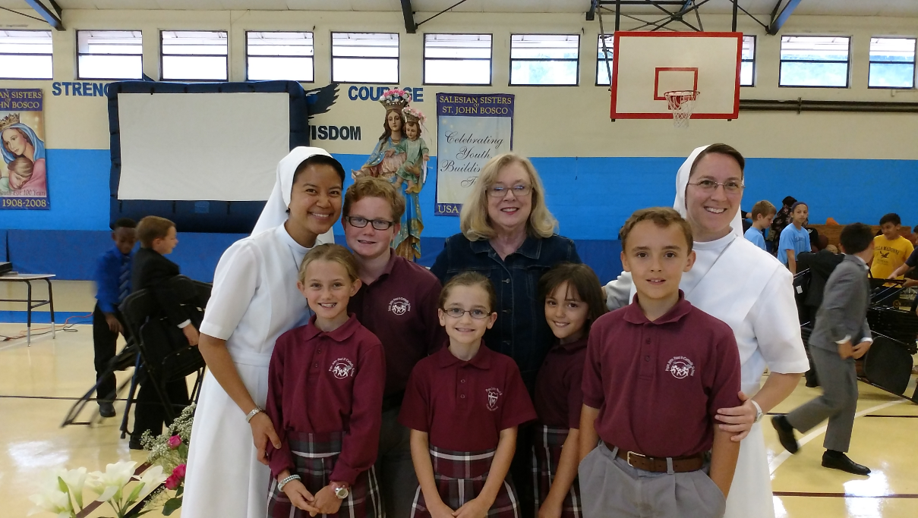

Pat Sobel and her Don Bosco Home in Florida - adopted children visit the Salesian Sisters at Villa Madonna School for a feast day celebration.
Association of Salesian Cooperators
St. Philip the Apostle Province (SUE)
June 2019

Slide 23
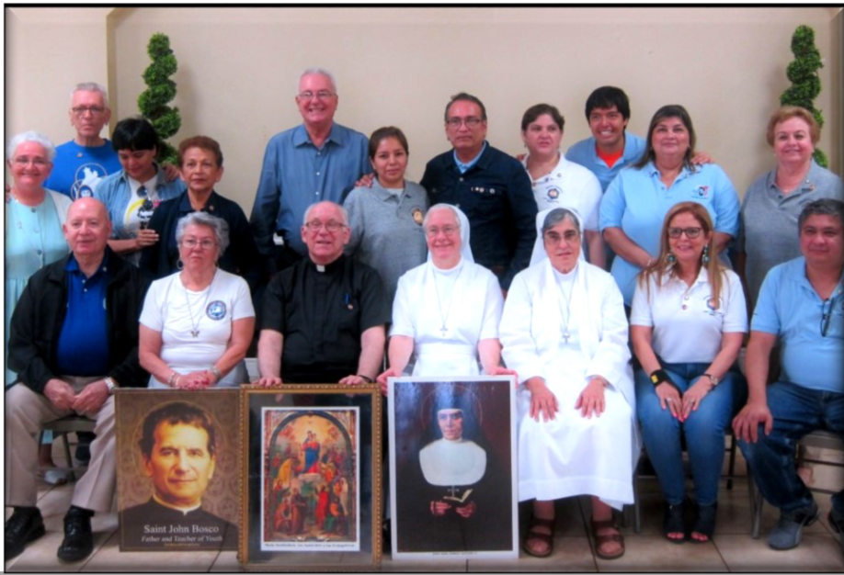
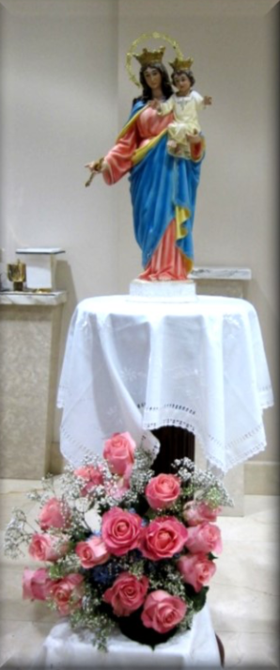
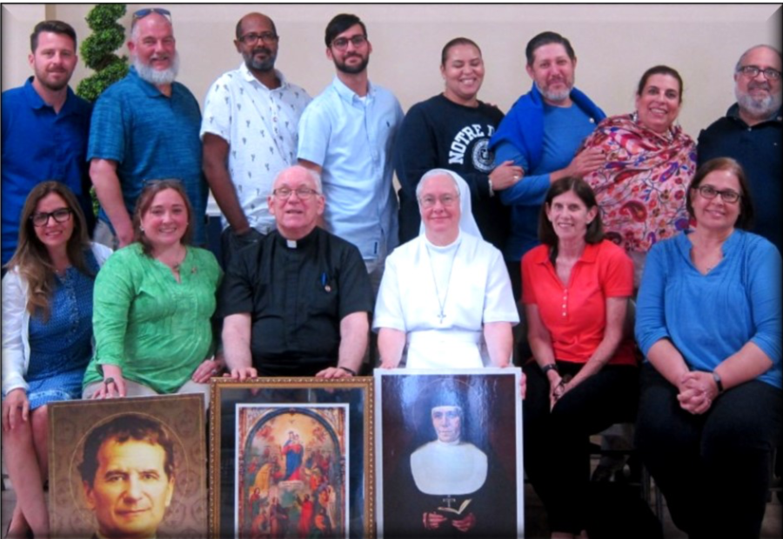
Miami, Florida

Slide 24
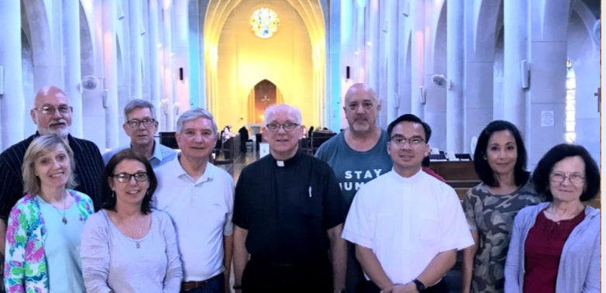
Atlanta, Georgia

Slide 25
