Slide 1
Which Salesian Cooperators for Today’s World?
Importance of Formation and Vocational Discernment for Aspirants
¿Qué cooperadores salesianos para el mundo de hoy?
La importancia de la formación y el discernimiento vocacional para los aspirantes
Notes:
My dear brothers and sisters, our formation topic for this session is “Which Salesian Cooperators for Today’s World? The importance of Formation and Vocational Discernment for Aspirants” I am honored to have this moment with you to deepen our understanding and shared commitment to effective formation, especially for our aspirants. My name is Judy Alvarez and I am the
Now as true Salesians let’s do some group warm-ups to get the blood flowing to our brains. Please stand and look at the kind of chocolate candy you have. You have 20 seconds to find 3 other persons who have chocolate candy different from yours.

Slide 2
Which Salesian Cooperators for Today’s World?
GOAL:
To identify formation as a fundamental element
to prepare Salesian Cooperators adequately
disposed to the vocation and mission
to which we are called today.
EL GOL: Identificar la formación como elemento fundamental para preparar adecuadamente a los Cooperadores Salesianos dispuestos a la vocación y a la misión a la que hoy estamos llamados.
Notes:
Our goal in this session is to identify formation as a fundamental element to prepare Salesian Cooperators adequately disposed to the vocation and mission to which we are called today.
To remain faithful to our beloved founder, what did Don Bosco say about our vocation and mission?

Slide 3
Which Salesian Cooperator for the World of Don Bosco?
“They are called Cooperators who wish to be involved in charitable works, not in a general way, but in a specific one – in harmony with and according to the spirit of the Congregation of St. Francis de Sales. One Cooperator can do good by himself, but the fruit shall remain rather limited, and, moreover, of short duration. On the contrary, when united to others, he finds support, counsel, encouragement, and, often with less labor, obtains more because even weak forces become strong when they are joined together. Thus says the well-known adage: “in unity is strength”
... And so, our Cooperators, following the goal of the Salesian Congregation, work according to their strength to gather together youth abandoned on the streets and in the piazza who are at risk, bringing them to catechetical instruction, entertaining them on non-workdays, helping them find an upright boss, guiding them, counseling them, and helping them as much is possible to become good Christians and honest citizens. The norms to be followed in these works which we propose to the Salesian Cooperators will be the material of the Salesian Bulletin.”
Notes:
Clearly Don Bosco envisioned Cooperators to be Good News, and engaging with zeal in the salvation of the young!

Slide 4
Which Salesian Cooperators for Today’s World?
Article 6 of the Statutes
“Salesian Cooperators live out their faith
in their own secular reality.
Taking inspiration from
Don Bosco’s apostolic project,
they have a strong sense of communion
with the other members of the Salesian Family.
They commit themselves
to the same mission to youth and to ordinary folk
in a fraternal and united way.”
Notes:
In Article 6 of the Project of Life we find this clear statement of who we are to be today:
“Salesian Cooperators live out their faith in their own secular reality. Taking inspiration from Don Bosco’s apostolic project, they have a strong sense of communion
with the other members of the Salesian Family. They commit themselves to the same mission to youth and to ordinary folk in a fraternal and united way.”
How can we prepare such Cooperators for today’s young people and those marginalized?

Slide 5
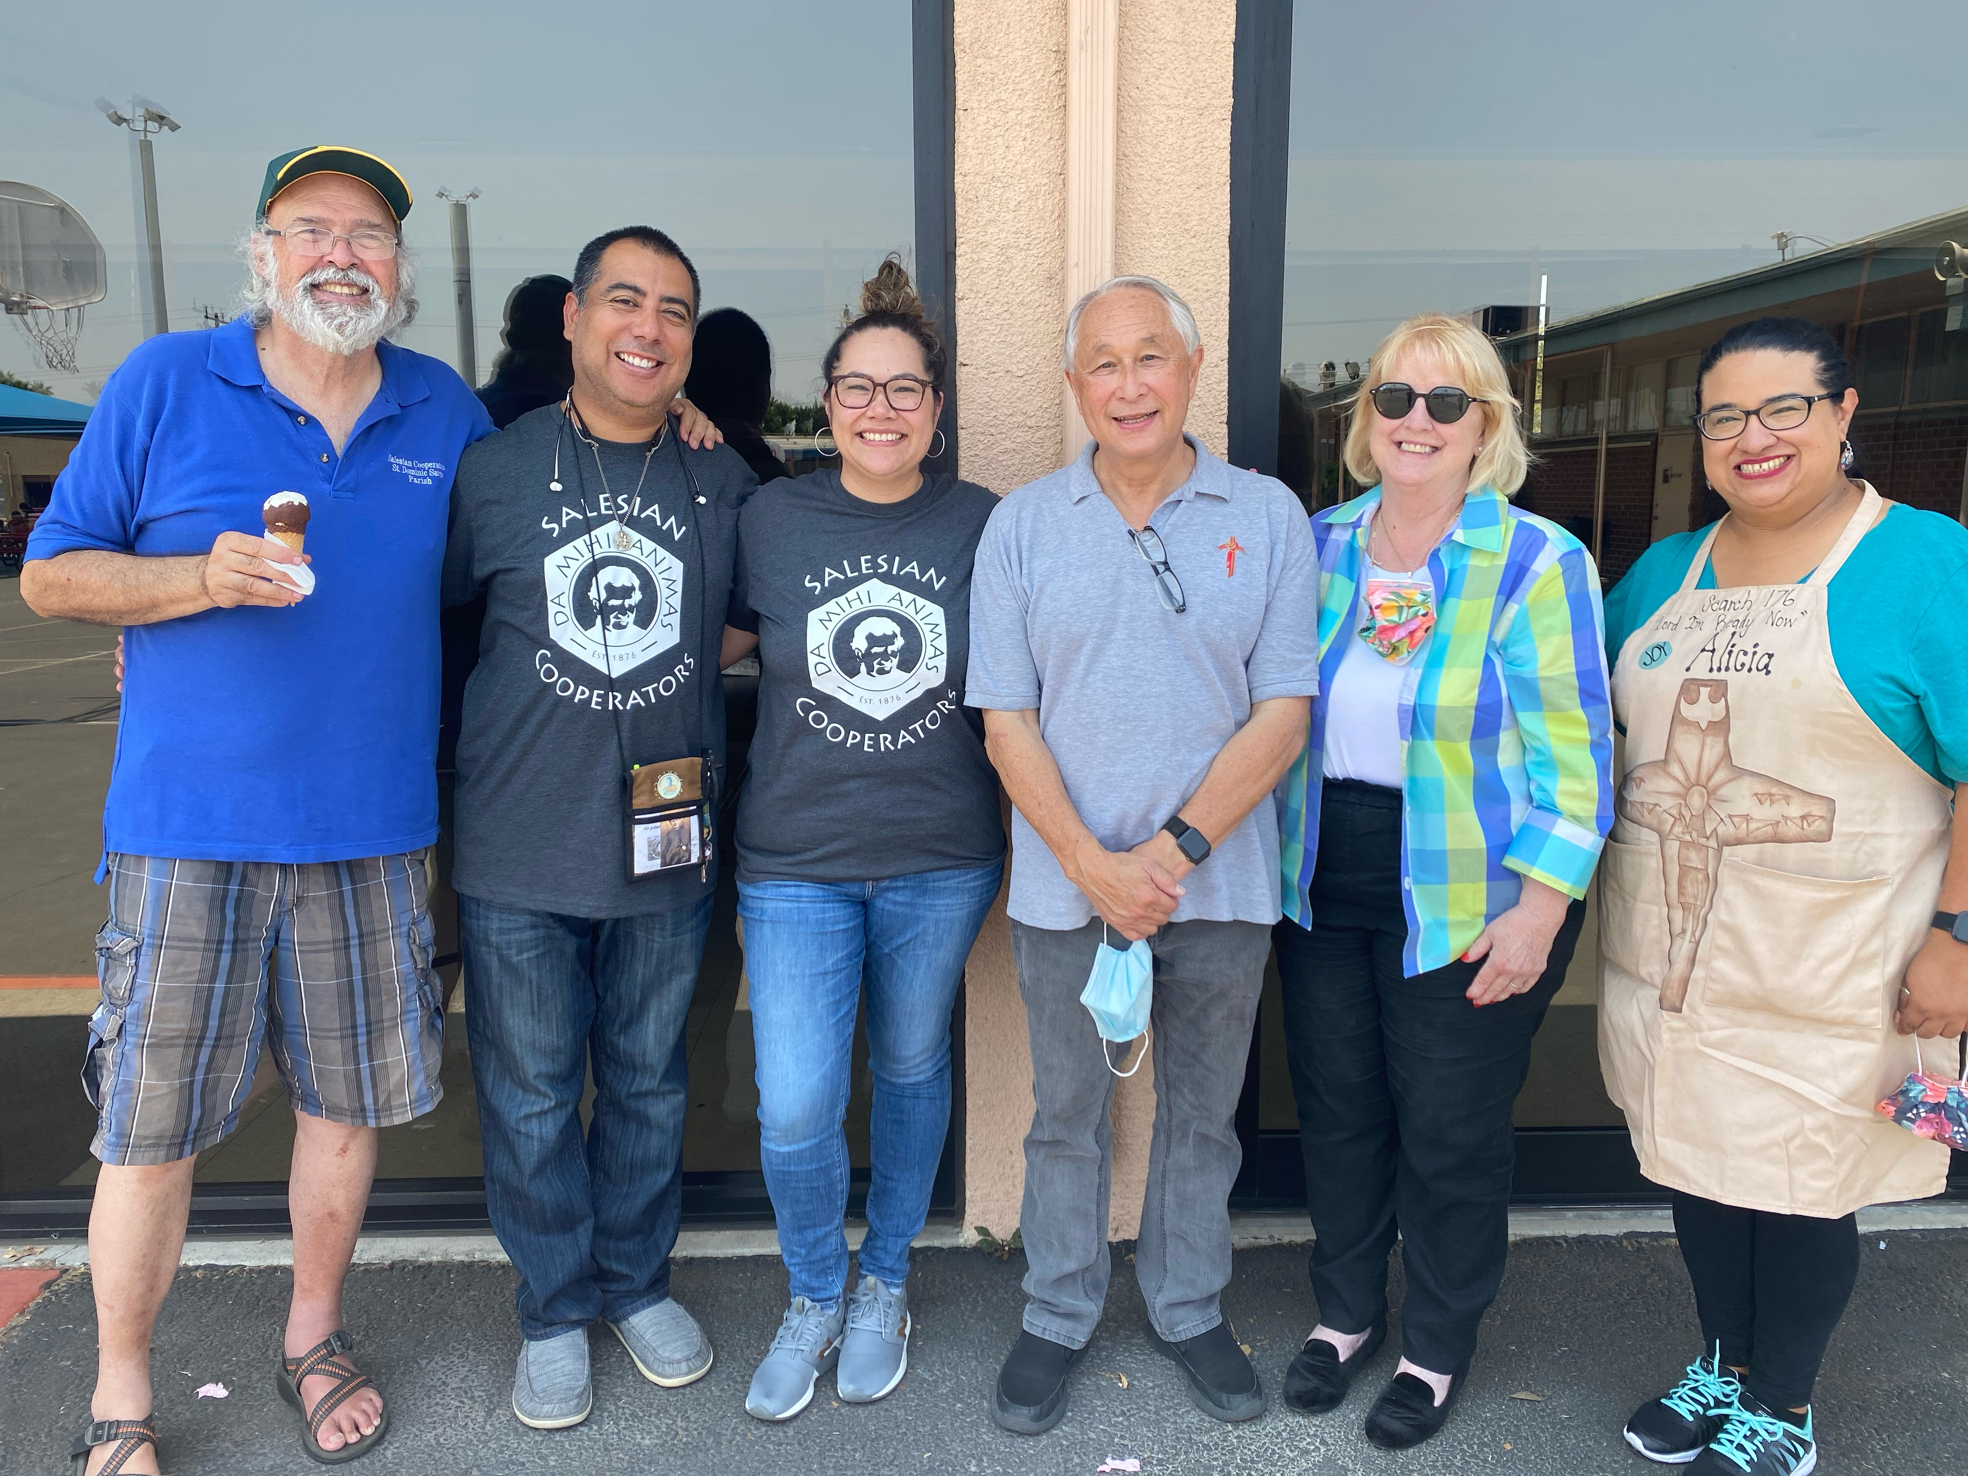
Joyful Ones!
¡Alegres!
Notes:
In your chocolate candy group or in the zoom chat identify any criteria you think is necessary to form joyful cooperators. You have 2 mins.
You now have 10 seconds to find another 2 persons who have chocolate candy just like yours.

Slide 6
RED FLAGS!
¡BANDERAS ROJAS!
Notes:
In your chocolate candy group or in the zoom chat identify any red flags / issues that are obstacles to forming joyful cooperators. You have 2 minutes.
I now invite you to share your candy with each other and make sure everyone gets one they like! Please return to your seats.

Slide 7
Which Salesian Cooperators for Today’s World?
Importance of Formation and Vocational Discernment for Aspirants
¿Qué cooperadores salesianos para el mundo de hoy?
La importancia de la formación y el discernimiento vocacional para los aspirantes.
Notes:
My dear friends, You and I know that formation is the work of God, and that we, as formators are here to help our aspirants to hear God’s call in the ordinary moments of their lives. However, to do this, we too must be able hear God’s voice in our lives. As aspirants and formators, sometimes we just don’t get it. We lose sight of our joy and only see red flags that make our hearts heavy. We need to remember who we are in God, the church, and the Salesian family, and also remember to whom we are sent.

Slide 8
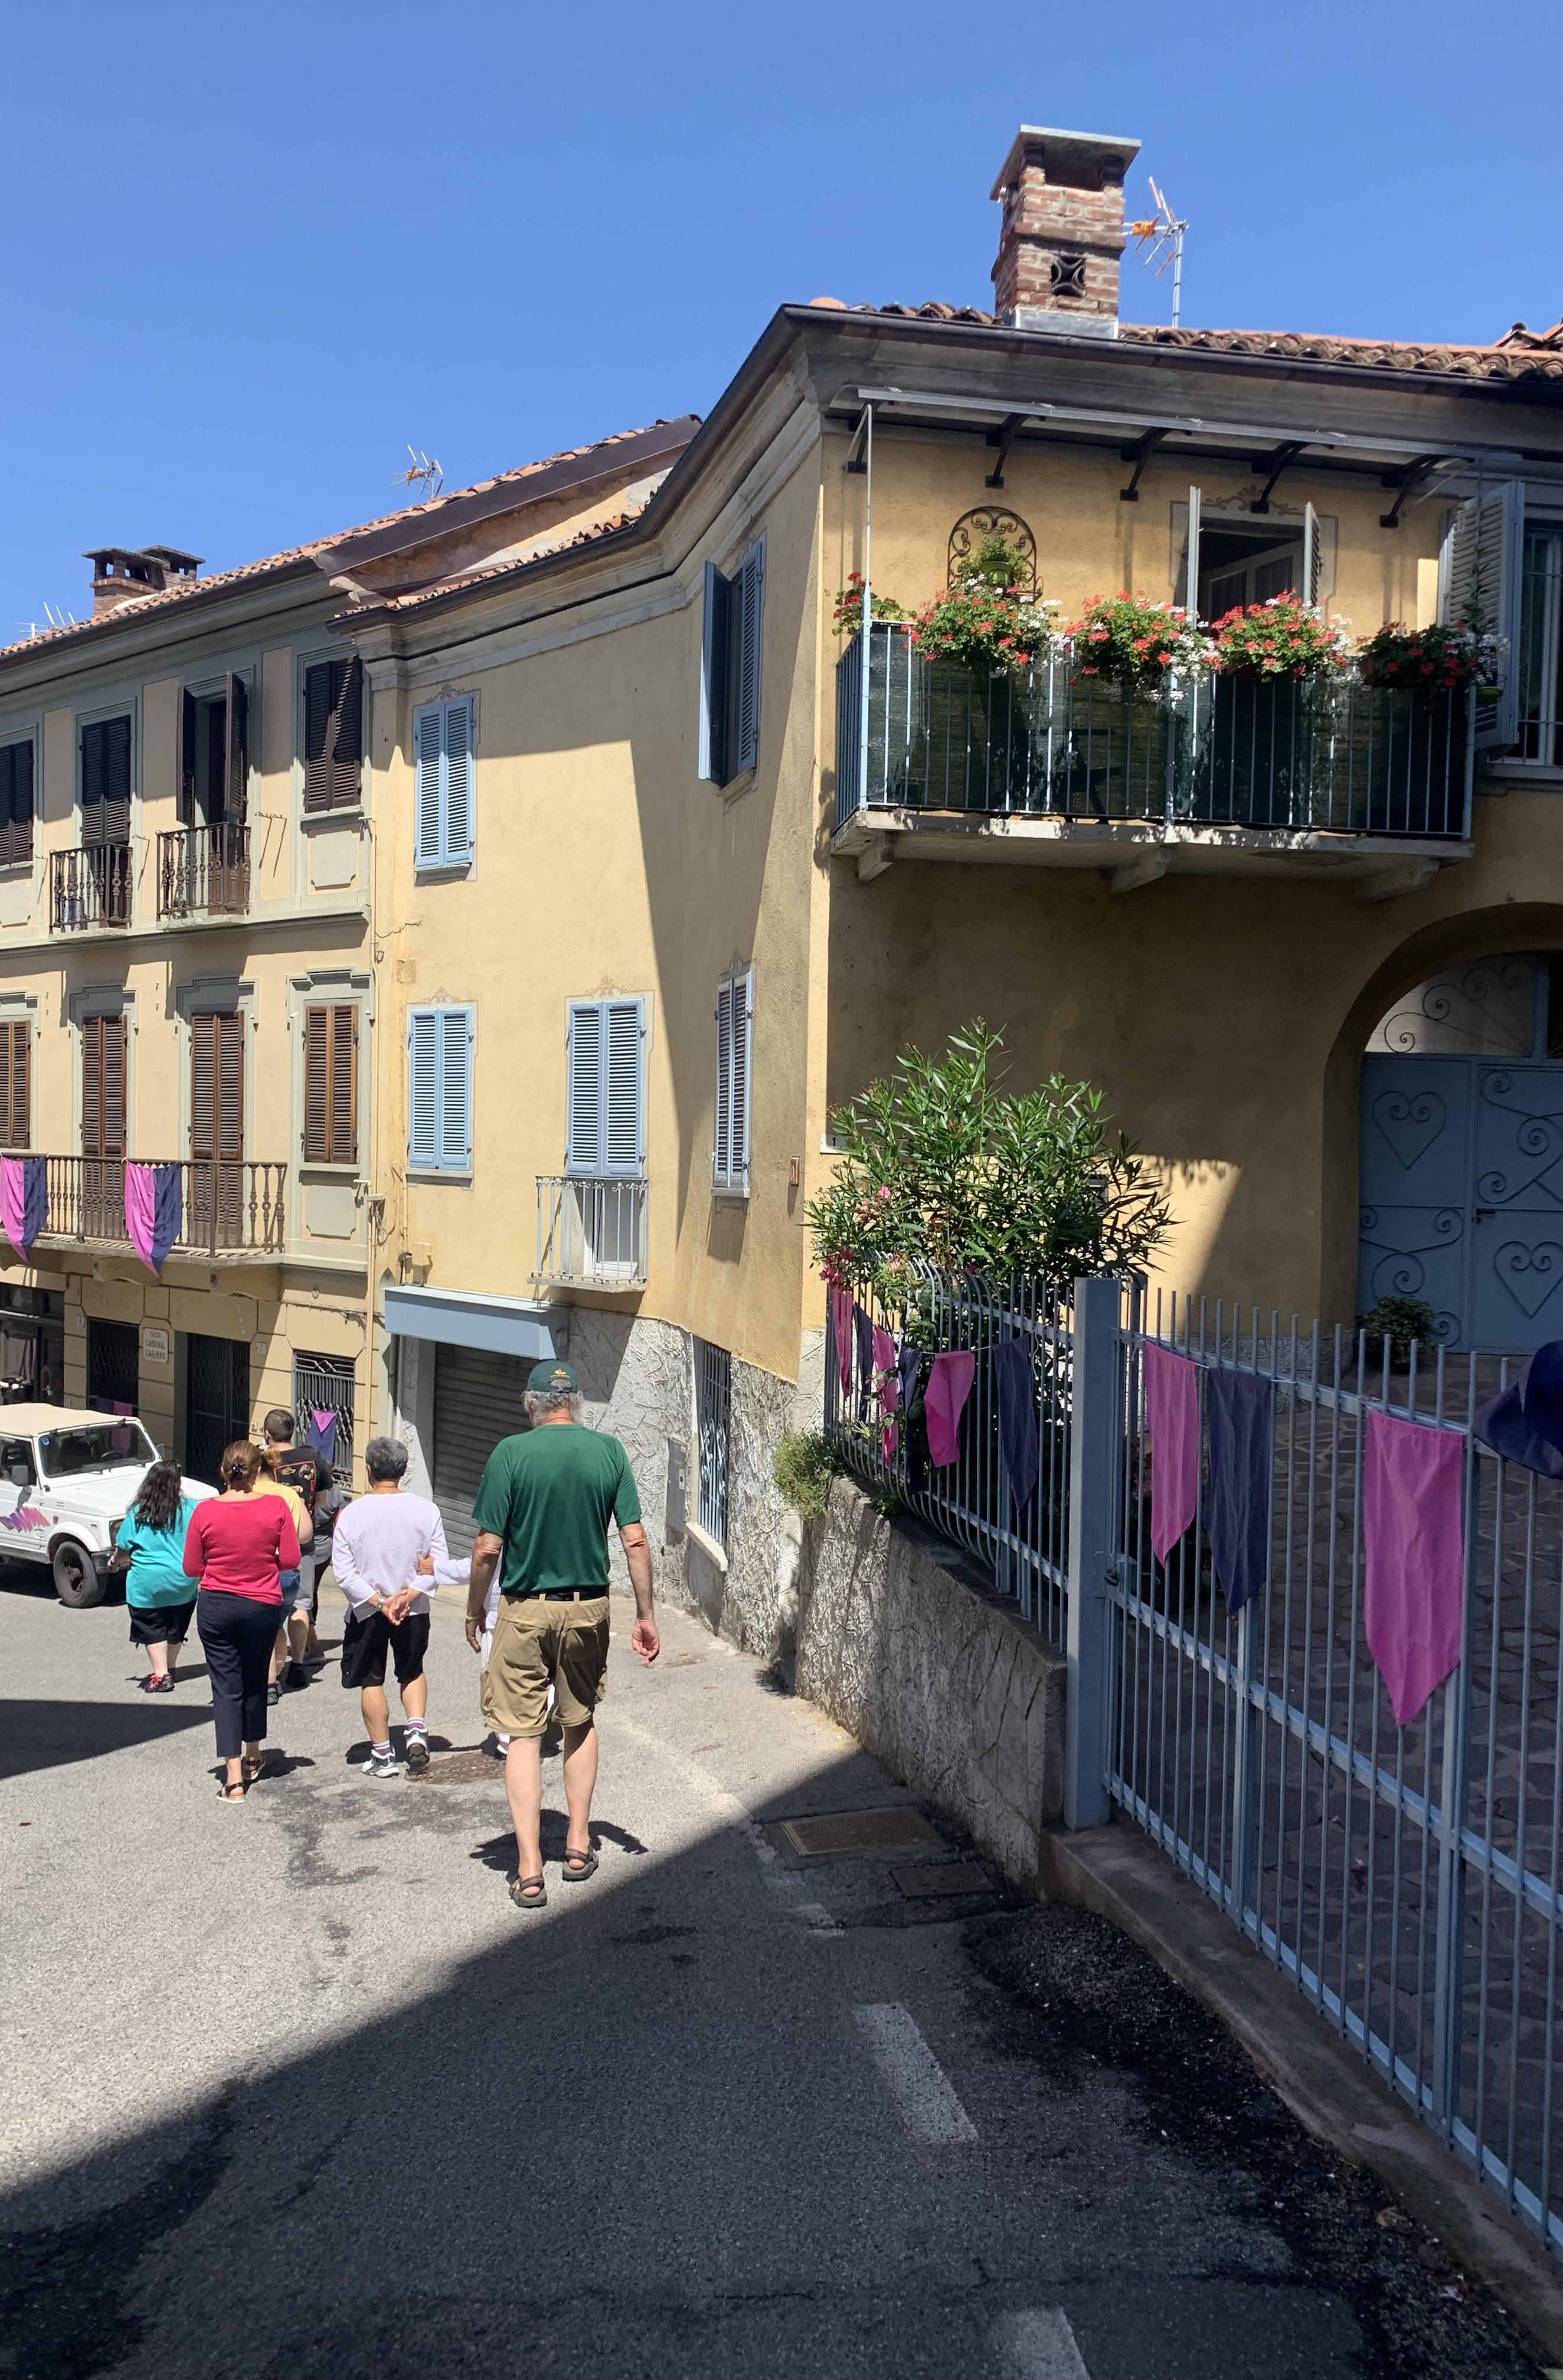
LET US PRAY
THE DISCIPLES ON THE WAY TO EMMAUS
Luke 24:1-35
OREMOS
LOS DISCÍPULOS CAMINO DE EMAÚS
Lucas 24:1-35
Notes:
In June my husband and I went to Rome on a Salesian Family Pilgrimage.
While in Rome we went to the the Church of the Quo Vadis, Domine.” In the apocryphal literature of the early Church there is a story of Peter which describes a familiar scene in the New Testament. According to this story, Peter flees from Rome during the persecution of Christians under the Emperor Nero; as he was travelling along the Appian Way he meets Christ in a vision. Astonished, he asked 'Domine quo vadis?” ('Lord, where are you going ?'). Christ replied that he was going to Rome to be crucified a second time. Peter then realized that his departure from the city was cowardly and returns to face whatever persecutions might befall him.
Isn’t it interesting that St. Paul had a similar moment of revelation when he is going off in the wrong direction to persecute Christians? In both cases Jesus comes to meet them going the wrong way. This kind of encounter happens again to the disciples on the Road to Emmaus who have chosen to leave Jerusalem after the death of Jesus.
In this reading of scripture, I invite you to use your imaginations to enter the experience of the disciples leaving Jerusalem, and to enter the experience of Jesus who accompanies them. We will take a few moments for this quiet reflection.

Slide 9
Luke 24: 13-35
Notes:
Luke 24, 13-35
That very day, the first day of the week, two of Jesus’ disciples were going to a village seven miles from Jerusalem called Emmaus, and they were conversing about all the things that had occurred. And it happened that while they were conversing and debating, Jesus himself drew near and walked with them, but their eyes were prevented from recognizing him. He asked them, “What are you discussing as you walk along?” They stopped, looking downcast. One of them, named Cleopas, said to him in reply, “Are you the only visitor to Jerusalem who does not know of the things that have taken place there in these days?” And he replied to them, “What sort of things?” They said to him, “The things that happened to Jesus the Nazarene, who was a prophet mighty in deed and word before God and all the people, how our chief priests and rulers both handed him over to a sentence of death and crucified him. But we were hoping that he would be the one to redeem Israel; and besides all this, it is now the third day since this took place. Some women from our group, however, have astounded us: they were at the tomb early in the morning and did not find his Body; they came back and reported that they had indeed seen a vision of angels who announced that he was alive. Then some of those with us went to the tomb and found things just as the women had described, but him they did not see” And he said to them, “Oh, how foolish you are! How slow of heart to believe all that the prophets spoke! Was it not necessary that the Christ should suffer these things and enter into his glory?” Then beginning with Moses and all the prophets, he interpreted to them what referred to him in all the Scriptures. As they approached the village to which they were going, he gave the impressing that he was going on farther. But they urged him, “Stay with us, for it is nearly evening and the day is almost over.” So, he went in to stay with them. And it happened that, while he was with them at table, he took bread, said the blessing, broke it, and gave it to them. With that their eyes were opened, and they recognized him, but he vanished from their sight. Then they said to each other, “Were not our hearts burning within us while he spoke to us on the way and opened the Scriptures to us?” So, they set out at once and returned to Jerusalem where they found, gathered together, the Eleven and those with them who were saying, “The Lord has truly been raised and has appeared to Simon!” Then the two recounted what had taken place on the way and how he was made known to them in the breaking of the bread.

Slide 10
The Human Experience
What were the disciples experiencing in themselves, between themselves, with Jesus the fellow traveler?
How was Jesus experiencing himself, the disciples and the journey they were taking together?
¿Qué estaban experimentando los discípulos en sí mismos, entre ellos, con Jesús el compañero de viaje?
¿Cómo se estaba experimentando Jesús a sí mismo, a los discípulos y al viaje que estaban haciendo juntos?
Notes:
What were the disciples experiencing in themselves, between themselves, with Jesus the fellow traveler?
How was Jesus experiencing himself, the disciples, and the journey they were taking together?

Slide 11
The Christian Experience
Enter the disciples’ experience of their hearts burning with love and understanding of Jesus.
Enter Jesus’ experience of his love and understanding flowing into the disciples in explaining the scriptures and in the Breaking of the Bread.
Entra en la experiencia de los discípulos de sus
corazones ardiendo de amor y comprensión de Jesús.
Entra en la experiencia de Jesús de su amor y comprensión que fluye en los discípulos al explicar las Escrituras y al partir el Pan.
Notes:
Enter the disciples’ experience of their hearts burning with love and understanding of Jesus.
Enter Jesus’ experience of his love and understanding flowing into the disciples in explaining the scriptures and in the Breaking of the Bread.

Slide 12
The Salesian Experience
How will I, like them, announce that I have seen the Risen Lord?
How will I accompany fellow Cooperator believers as did the Risen Lord?
La experiencia salesiana
¿Cómo anunciaré, como ellos, que he visto al Señor resucitado?
¿Cómo acompañaré a los demás creyentes Cooperadores como lo hizo el Señor Resucitado?
Notes:
The Salesian Experience
How will I, like them, announce that I have seen the Risen Lord?
How will I accompany fellow Cooperator believers, as did the Risen Lord?
Embracing our call and moving beyond any obstacles, we are sent to be Good news for our brothers and sisters, including the young and those most in need.
Glory be to the Father,
Everyone continues:
And to the Son, and to the Holy Spirit;
as it was in the beginning, is now, and ever shall be
world without end.
Amen.

Slide 13
GOAL OF INITIAL FORMATION
To accompany the Aspirants as they discern and mature in their own personal vocation to assume a responsible commitment to the Church.
ASC Formation Guidelines, 3.1.1
ACCOMPANIMENT
It is important that the Aspirants feel the Association is close to their experience and sustaining them both humanly and spirituality.
They especially need to feel accompanied and integrated into the life of the Local Center, and participate actively in the encounters, gatherings, and initiatives.
ASC Formation Guidelines, 3.1.5
Initial Formation
Notes:
SLIDE 13
GOAL OF INITIAL FORMATION
To accompany the Aspirants as they discern and mature in their own personal vocation to assume a responsible commitment to the Church.
ASC Formation Guidelines, 3.1.1
The role of those who accompany the aspirant is not to convince them of their call, but to allow them to discover it through their experience of formation that should foster their growth as a human person, a Christian, and a Salesian. From what we heard yesterday in Antonio’s talk, what kind of responsible commitment to the Church does a Cooperator make? (make the point of being a lay person in the world, as the light of Christ there…)
ACCOMPANIMENT
It is important that the Aspirants feel the Association is close to their experience and sustaining them both humanly and spirituality.
A formative journey takes time, and during that time life happens, both joyful and difficult. At times the aspirant’s participation may be derailed by a change in employment, personal/ FAMILY SICKNESS, OR the death of a loved one. This situation can become an opportunity to live Salesian spirituality in a deeper way. Our accompaniment can help guide them, but they may or may not complete our “formation program.” Still your friendship that remains open and supportive of them is the greatest lesson anyone can teach.
Always remember that God is the formator who has the formation plan of a lifetime for them. our primary role is to help the aspirants to listen to what God is teaching them in their life journey whether they are in our formation program or not.
They especially need to feel accompanied and integrated into the life of the Local Center, and participate actively in the encounters, gatherings, and initiatives.
We offered initial formation programs that aspirants from different centers could attend. One at the province level and one at the local level. It was expected that members of the Local center would accompany the aspirants. Likewise, it was expected that the aspirants would attend the Local Center meetings. These are big expectations! There were varying success stories from our two experiences. however, for those aspirants who made their cooperator promise and those who will soon do so there is one common factor. how well did the Center know them as a brother / sister in Christ, and how well did they feel accompanied.
ASC Formation Guidelines, 3.1.5

Slide 14
Proposing forms of communion and collaboration
The accompaniment process involves:
Method of Accompaniment
Cultivating a sense of belonging to the Association
Walking next to the aspirant
Initial Formation
Knowing how to involve and help one become co-responsible
Knowing how to listen and be creative
Método de acompañamiento. El proceso de acompañamiento implica: caminando junto al aspirante; saber escuchar y ser creativo; saber cómo involucrar y ayudar a uno a ser corresponsable; cultivar un sentido de pertenencia a la Asociación; proponer formas de comunión y colaboración.
Notes:
SLIDE 14
Method of Accompaniment
The accompaniment process involves:
Walking beside the Aspirant, helping them to know they are loved, and that God loves them and sees them.
Knowing how to listen and being creative in helping them recognize the footsteps of God walking with them, asking questions, like Jesus, or sending them to GO AND SERVE….so they can discover the joy of love and service with the young and the poor
Knowing how to involve and help them become co-responsible in the life and initiatives of the Center….start small or big, depending on the person, fostering their growth in skills for relationship with others, especially youth, and collaboration too.
Cultivating a sense of belonging to the Association, through participation also in province, regional, and world initiatives. Explore ANS news at every session!
Proposing forms of communion and collaboration at the level of the Center, the diocese, the province, and worldwide Salesian family, e.g. retreats for youth and families, outreach projects, festivals, and fundraising

Slide 15
Accompaniment must lead to an authentic vision of Salesian life as a joyful commitment and service to the young and to the poorer classes of people, leading one to work at their side in the spirit of the da mihi animas cetera tolle.
- ASC Formation Guidelines, 3.1.5
Method of Accompaniment
Initial Formation
Método de acompañamiento. El acompañamiento debe conducir a una auténtica visión de la vida salesiana como un compromiso gozoso y un servicio a los jóvenes y a las clases más pobres, que los lleve a trabajar a su lado en el espíritu del da mihi animas cetera tolle.
Notes:
Accompaniment must lead to an authentic vision of Salesian life as a joyful commitment and service to the young and to the poorer classes of people, leading one to work at their side in the spirit of the da mihi animas cetera tolle.
- ASC Formation Guidelines, 3.1.5

